Slide 1
Asset Performance Management System for grain processing industry SAKURA-APM PaaS SAKURA-IIoT based
Interim Report 3.rd O.C. for TTE’s
INNOVINNPROM
Andrii Lukhverchyk
Centre 4.0 KPI DIH
DIH PIAP

Slide 2
Executive summary of TTE
Preparations have been made for the processing of Big Data coming from the operating grain elevator:
Optimized technology stack.
Updated the version and added new features to the system software.
Developed a new version of the SCADA software.
Updated PLC software version.
Systematized and analyzed input data.
Developed algorithms for the use of neural networks.
Conducted preliminary experiments on the use of artificial intelligence to analyze the possibility of optimizing the efficiency of technological processes.
Many mentoring meetings from Centre 4.0 KPI DIH have been held. As a result, SMEs are fully satisfied with the received support which included assistance in setting up technical processes, technical and business consulting, etc. PIAP DIH helped a lot during TTE planning with technical and business advices.
Notes:
Brief overview what was done and what was reached up to midterm review.
Короткий огляд того, що було зроблено та чого досягнуто до проміжного огляду.

Slide 3
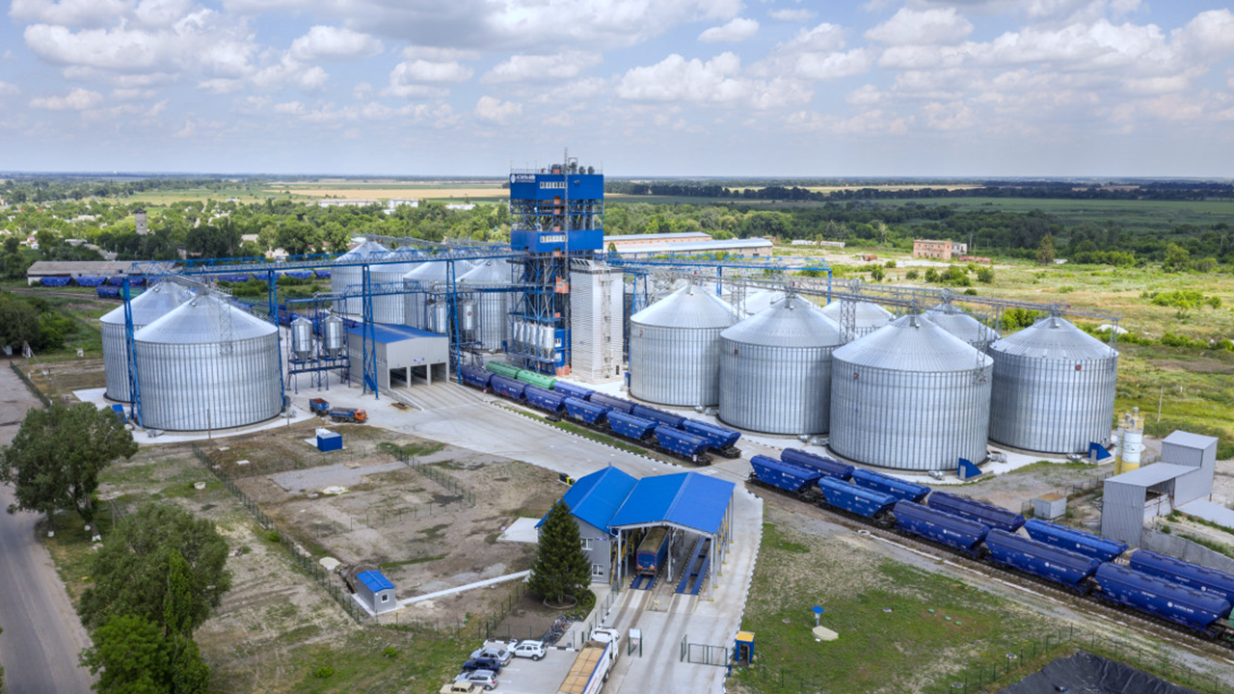
Description 1:
Object of Project Implementation
The volume of fully loaded grain storage is 100,000 tons
SCADA - Automated design system “Route” INNOVINNPROM
PLC – Siemens S7-1500, 1500 DI/DO/AI/AO
Notes:
Support from BOWI and benefit from that.
Підтримка від BOWI та користь від цього.

Slide 4
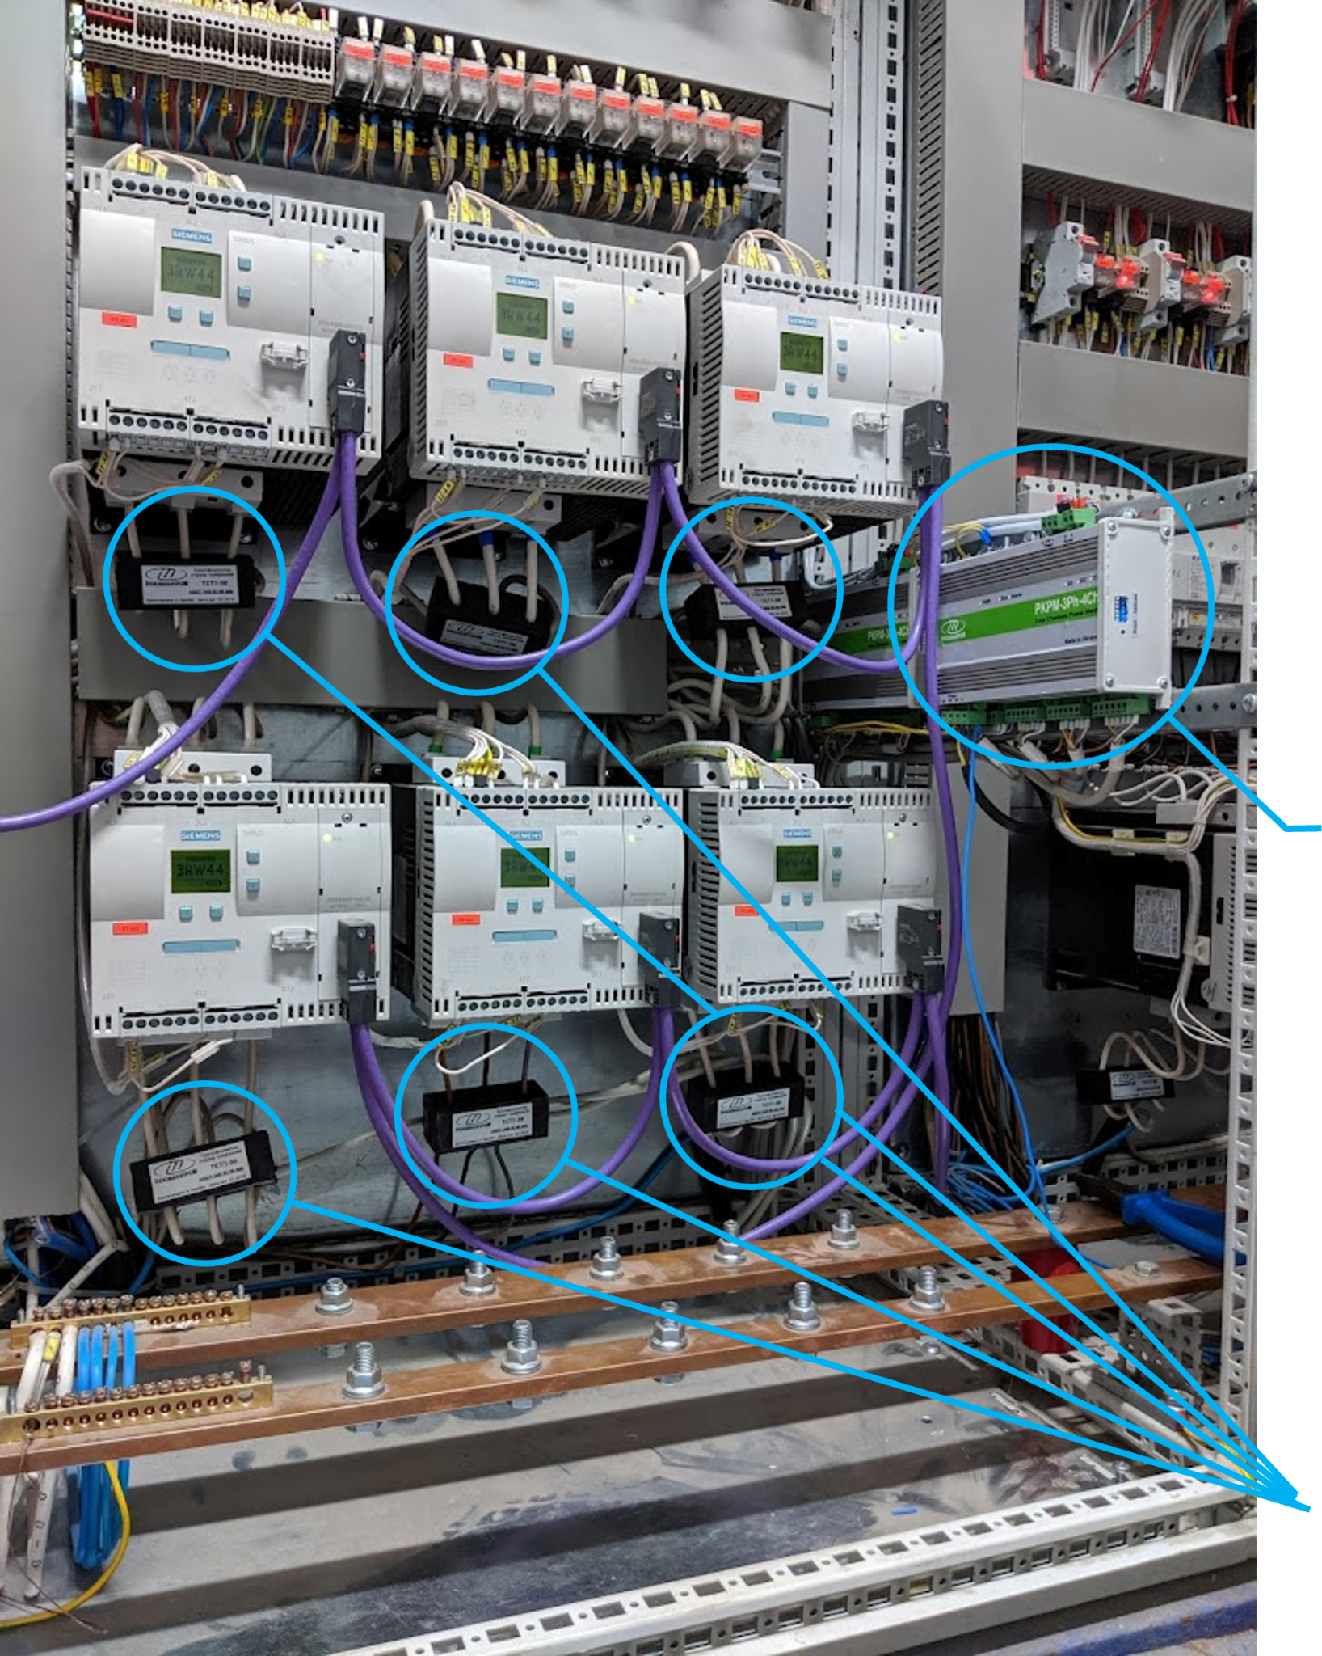
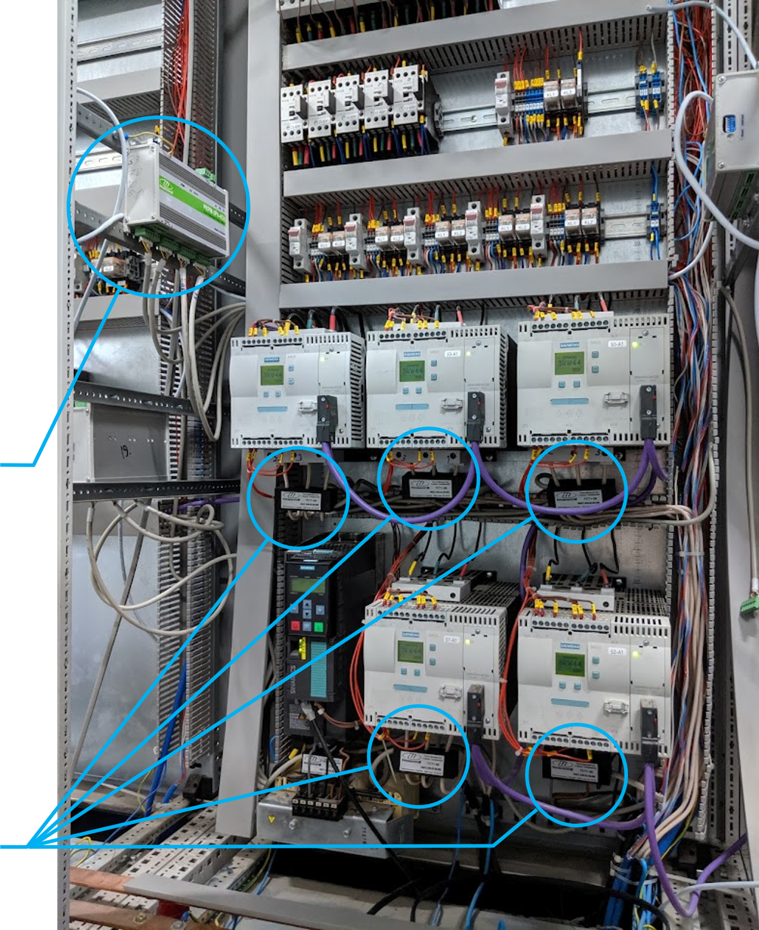
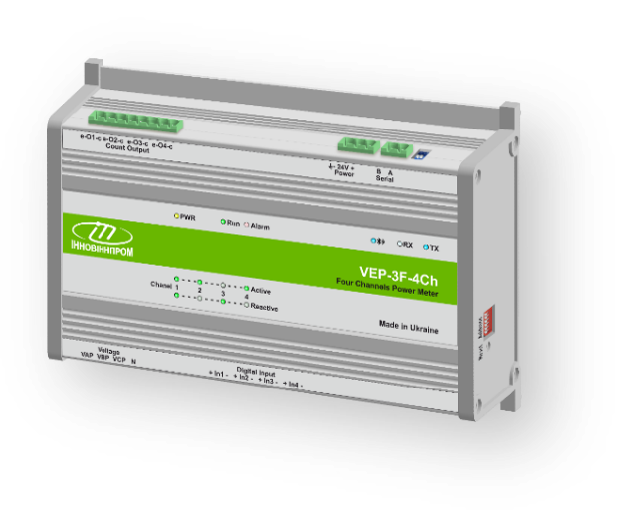
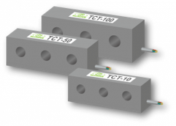
Description 2:
System Equipment
Installed:
Power Meters 17 units
Transformers 65 units
IoT Gateways 2 units
Total:
65 units controlled equipment
3,000 control channels per second
4 Channel Smart Power Meters INNOVINNPROM
Innovative 3 Phase Transformers INNOVINNPROM
Notes:
Brief overview what was done and what was reached up to midterm review.
Короткий огляд того, що було зроблено та чого досягнуто до проміжного огляду.

Slide 5
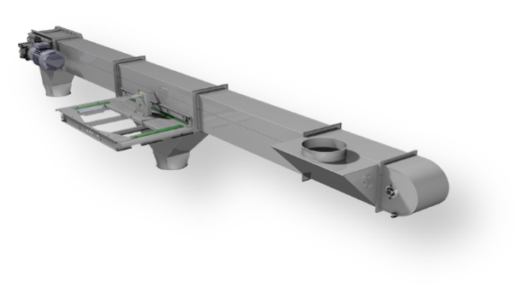
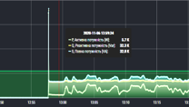
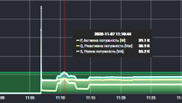
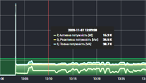
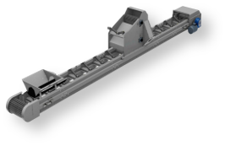
Description 3:
Equipment and Routes Options
Technological route
horizontal conveyor
Eq.3
Route operating time
The procedure for turning on the equipment
Technological delay
Technological delay
Direction of movement of products
Eq.1
Eq.2
Eq.3
The procedure for turning on the equipment
Eq.2
noria
Power-on time
Three-phase voltage
Three-phase current
Power factor (cos φ)
Active, reactive, full power
Active, reactive, full energy
Time out
Product
Bearing temperature
Status of the sensors
Term of work
Term of maintenance
Season
Time of day
Work shift
Power-on time
Three-phase voltage
Three-phase current
Power factor (cos φ)
Active, reactive, full power
Active, reactive, full energy
Time out
Product
Bearing temperature
Status of the sensors
Term of work
Term of maintenance
Season
Time of day
Work shift
Power-on time
Three-phase voltage
Three-phase current
Power factor (cos φ)
Active, reactive, full power
Active, reactive, full energy
Time out
Product
Bearing temperature
Status of the sensors
Term of work
Term of maintenance
Season
Time of day
Work shift
Route operating time
Power-on time
Active, reactive, full energy
Time out
Product
Season
Time of day
Work shift
horizontal conveyor
Eq.1
Direction of movement of products
The equipment involved in the route is turned on starting from the last device, turned off starting from the first device

Slide 6
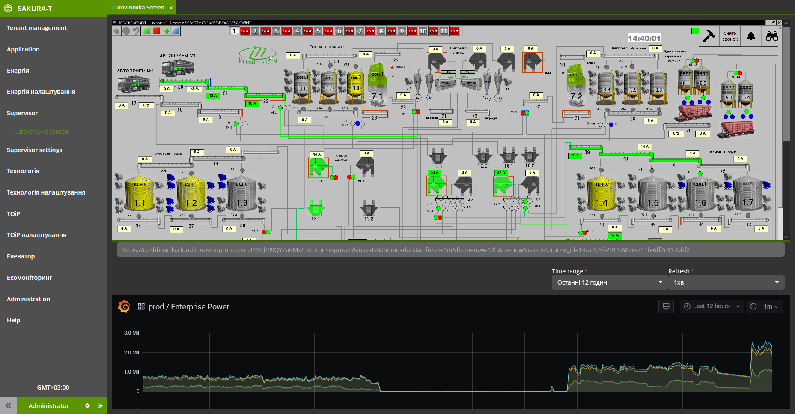
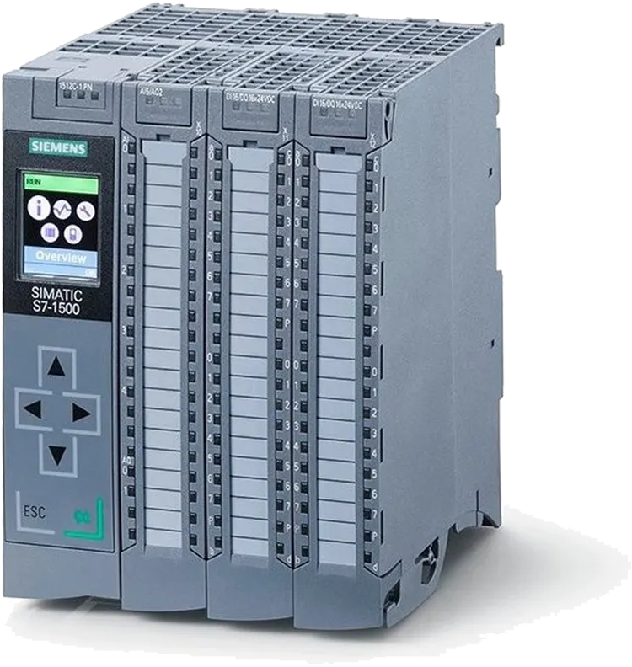
Deliverable 1:
New Version of SCADA Software
Add support for SCADA for export data for creating Digital Twin.
Added support for the ID of each operation and each technological route.
Implemented Ukrainian-language interface
Development of a new version of the PLC firmware.
Notes:
Presentation of each Deliverable of Project that should have been delivered up to mid term review, what was done and how it connects to the TTE.
Презентація кожного результату проекту, який мав бути наданий до проміжного огляду, що було зроблено та як це пов’язано з TTE.
Each on separate slide
Кожен на окремому слайді

Slide 7
Deliverable 2:
Digital Twin Production
Notes:
Presentation of each Deliverable of Project that should have been delivered up to mid term review, what was done and how it connects to the TTE.
Презентація кожного результату проекту, який мав бути наданий до проміжного огляду, що було зроблено та як це пов’язано з TTE.
Each on separate slide
Кожен на окремому слайді

Slide 8
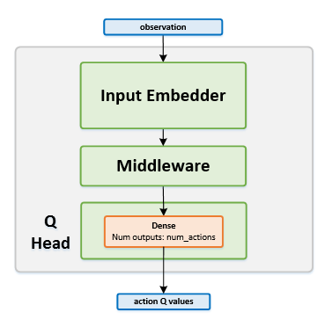
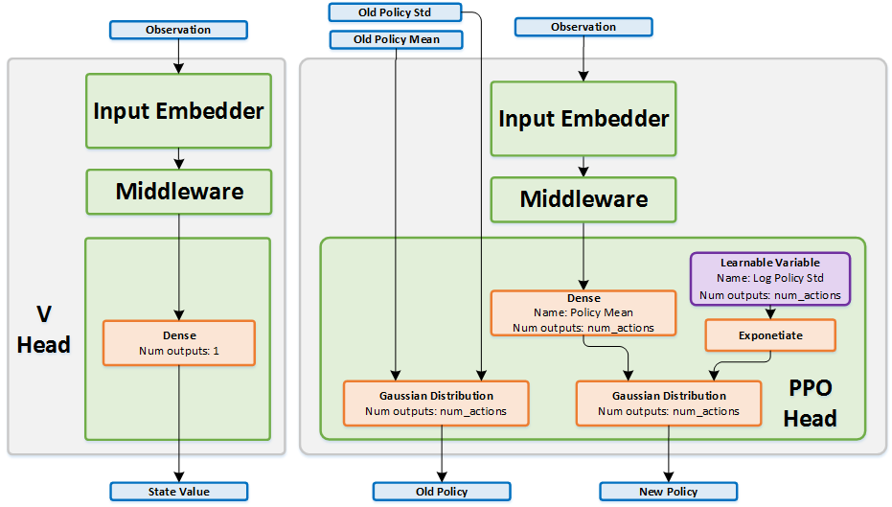
Deliverable 3:
Analysis of analogues for the optimization of the TP using intelligent information technology
Block diagram DQN
Block diagram PPO
Notes:
Presentation of each Deliverable of Project that should have been delivered up to mid term review, what was done and how it connects to the TTE.
Презентація кожного результату проекту, який мав бути наданий до проміжного огляду, що було зроблено та як це пов’язано з TTE.
Each on separate slide
Кожен на окремому слайді

Slide 9
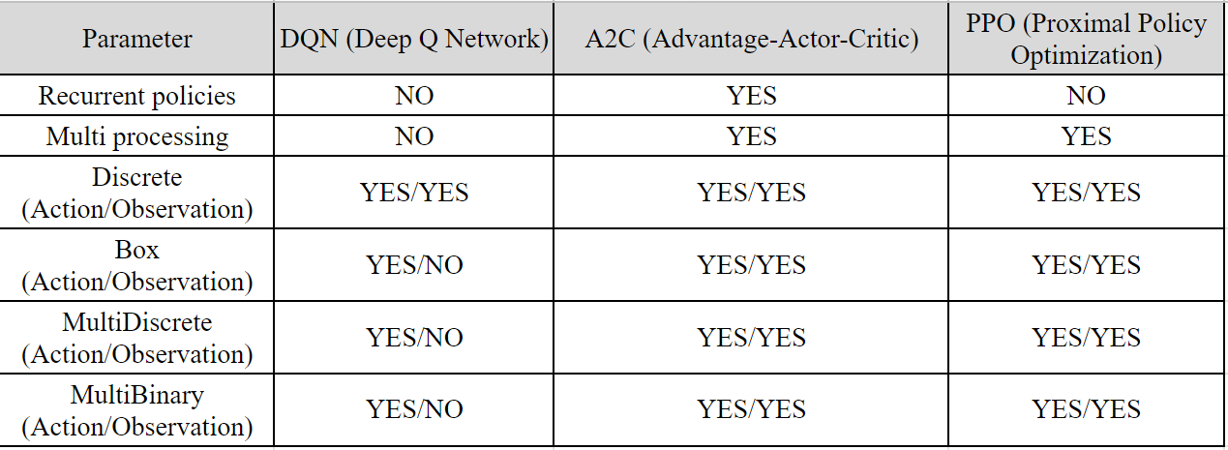
Deliverable 3:
Comparative table of analogues for the optimization of the TP using intelligent information technology
The best option is intellectual method A2C with reinforcement learning
Notes:
Presentation of each Deliverable of Project that should have been delivered up to mid term review, what was done and how it connects to the TTE.
Презентація кожного результату проекту, який мав бути наданий до проміжного огляду, що було зроблено та як це пов’язано з TTE.
Each on separate slide
Кожен на окремому слайді

Slide 10
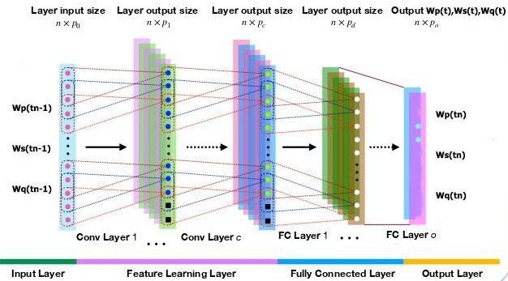
Deliverable 4:
Architecture neural networks of typical nodes of grain elevator route devices : option 1
Prediction of three output parameters at once based on the same three input parameters, the same outputs of the previous node at the previous moment in time by one convolutional neural network (CNN) with a complex architecture CNN model
Notes:
Presentation of each Deliverable of Project that should have been delivered up to mid term review, what was done and how it connects to the TTE.
Презентація кожного результату проекту, який мав бути наданий до проміжного огляду, що було зроблено та як це пов’язано з TTE.
Each on separate slide
Кожен на окремому слайді

Slide 11
Deliverable 4:
Architecture neural networks of typical nodes of grain elevator route devices : option 2
Prediction of each output parameter by a separate neural network, for example with architecture RBF (Radial Basis Function)
Notes:
Presentation of each Deliverable of Project that should have been delivered up to mid term review, what was done and how it connects to the TTE.
Презентація кожного результату проекту, який мав бути наданий до проміжного огляду, що було зроблено та як це пов’язано з TTE.
Each on separate slide
Кожен на окремому слайді

Slide 12
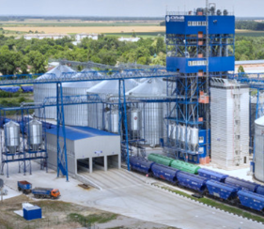
Deliverable 5:
The algorithm of our intelligent technology for grain elevator with TP devices optimization
Stage 1: Preparatory. Information is collected and neural network models of all nodes of all possible routes are built for the input parameters of different batches of grain.
Stage 2: Initial. A new batch of grain arrives at the elevator. It is examined and input parameters are determined. According to the models built in stage 1, the outputs of all nodes are estimated. Based on these forecast data, the optimal route is determined as the first version.
Stage 3: Optimization. The grain is processed according to the optimal route determined in step 2. The actual outputs of the nodes of this route are measured. If they do not coincide with the predicted ones, then a new multi-agent route model is built using reinforcement learning and neural networks, which is constantly updated with new data and which determines the true optimal route.
Notes:
Presentation of each Deliverable of Project that should have been delivered up to mid term review, what was done and how it connects to the TTE.
Презентація кожного результату проекту, який мав бути наданий до проміжного огляду, що було зроблено та як це пов’язано з TTE.
Each on separate slide
Кожен на окремому слайді

Slide 13
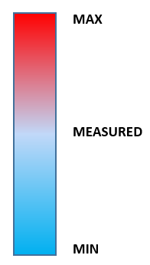
Deliverable 5:
Planning of experiments necessary for training of neural network models of nodal devices and system as a whole
At the experimental stage, data from stage 1 of our intellectual technology will be taken and the implementation of stages 2 and 3 will be simulated - as if only the input parameters are known. The result will be compared with the measured values. The other 2 experiments will concern much larger and much smaller parameter values ​​with a larger and smaller load (for example, more moist and dense and vice versa) to check how the algorithm will behave in extreme conditions.
SYSTEM
Ws,Wp,Wq
Notes:
Presentation of each Deliverable of Project that should have been delivered up to mid term review, what was done and how it connects to the TTE.
Презентація кожного результату проекту, який мав бути наданий до проміжного огляду, що було зроблено та як це пов’язано з TTE.
Each on separate slide
Кожен на окремому слайді

Slide 14
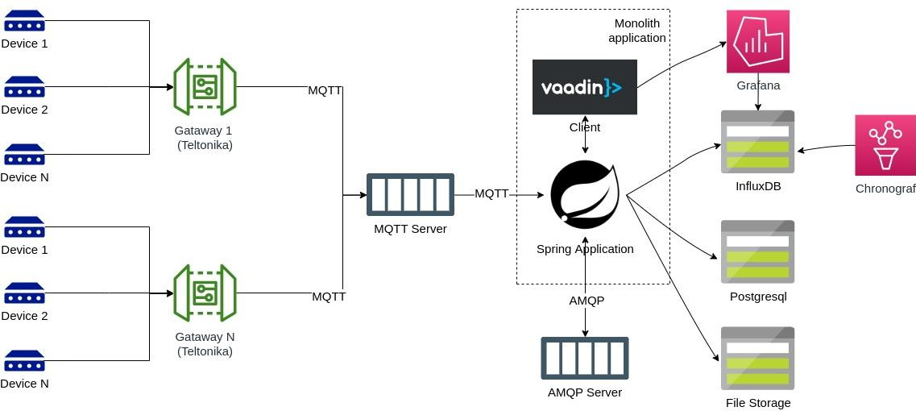
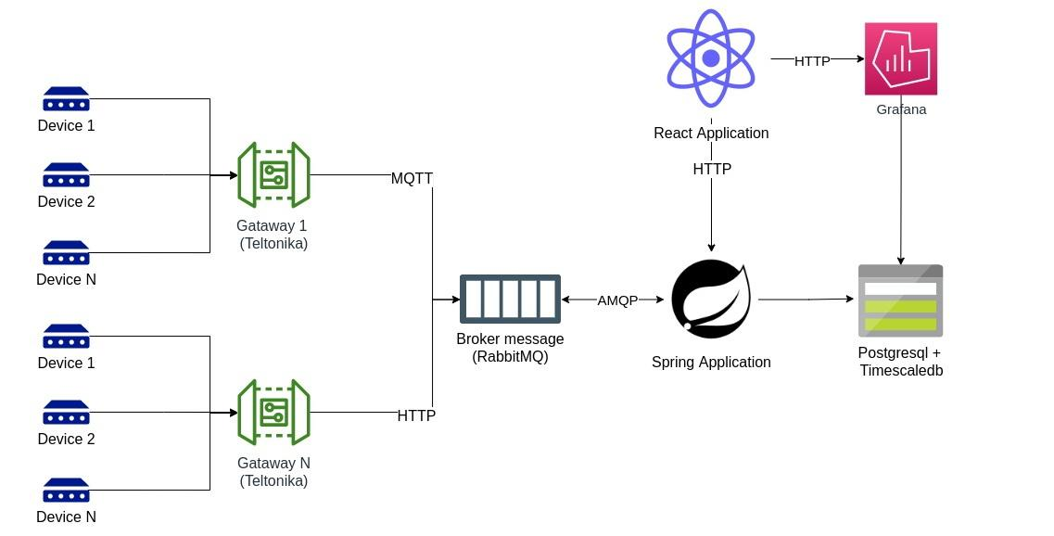
Deliverable 6:
Optimize the Technology Stack
The monolithic application was divided into a client and a server.
Moved the client part from Vaadin to React. This provides more opportunities for development, simplifies maintenance, allows for easier configuration of horizontal scaling.
Due to the TimescaleDB extension for PostgreSQL, we excluded the time series database (Influxdb) and the administration tool (Chronograf).
Moved the Mqtt server to RabbitMQ, due to the Rabbit-MQTT plugin.
PostgreSQL is used to store files.
We increased the fault tolerance of the application due to the introduction of a two-way queue in RabbitMQ.
Notes:
Presentation of each Deliverable of Project that should have been delivered up to mid term review, what was done and how it connects to the TTE.
Презентація кожного результату проекту, який мав бути наданий до проміжного огляду, що було зроблено та як це пов’язано з TTE.
Each on separate slide
Кожен на окремому слайді

Slide 15
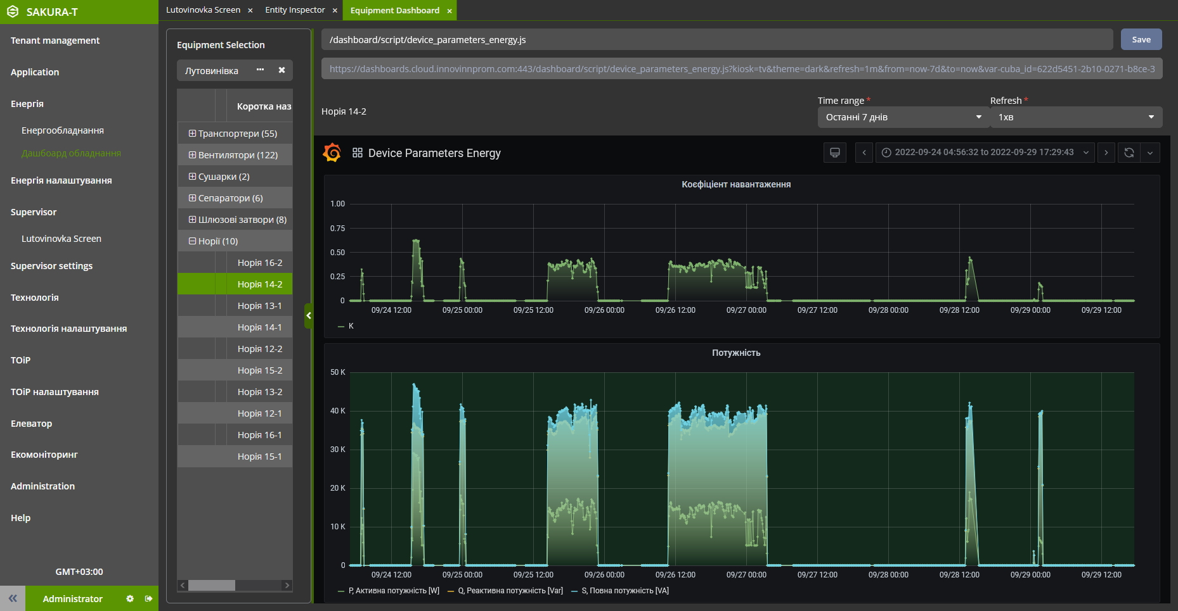
Deliverable 7:
New Version of System Software
Added support of application localization. Added English locale.
Added dark theme to web interface of the system.
The structure of the menu and interface windows has been changed.
Notes:
Presentation of each Deliverable of Project that should have been delivered up to mid term review, what was done and how it connects to the TTE.
Презентація кожного результату проекту, який мав бути наданий до проміжного огляду, що було зроблено та як це пов’язано з TTE.
Each on separate slide
Кожен на окремому слайді

Slide 16
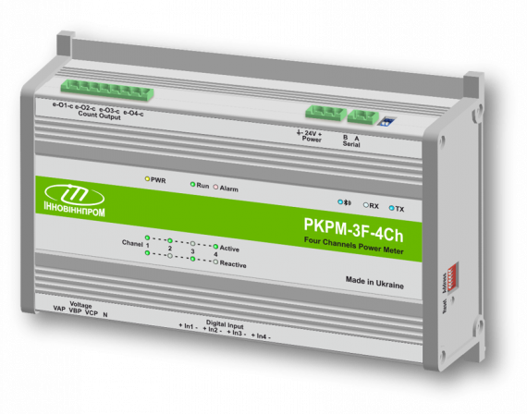
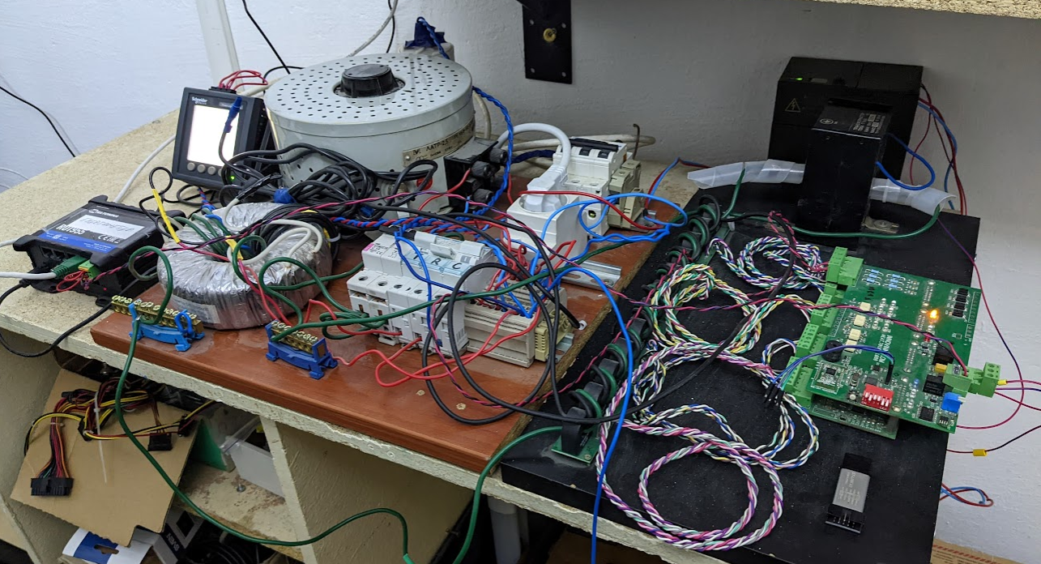
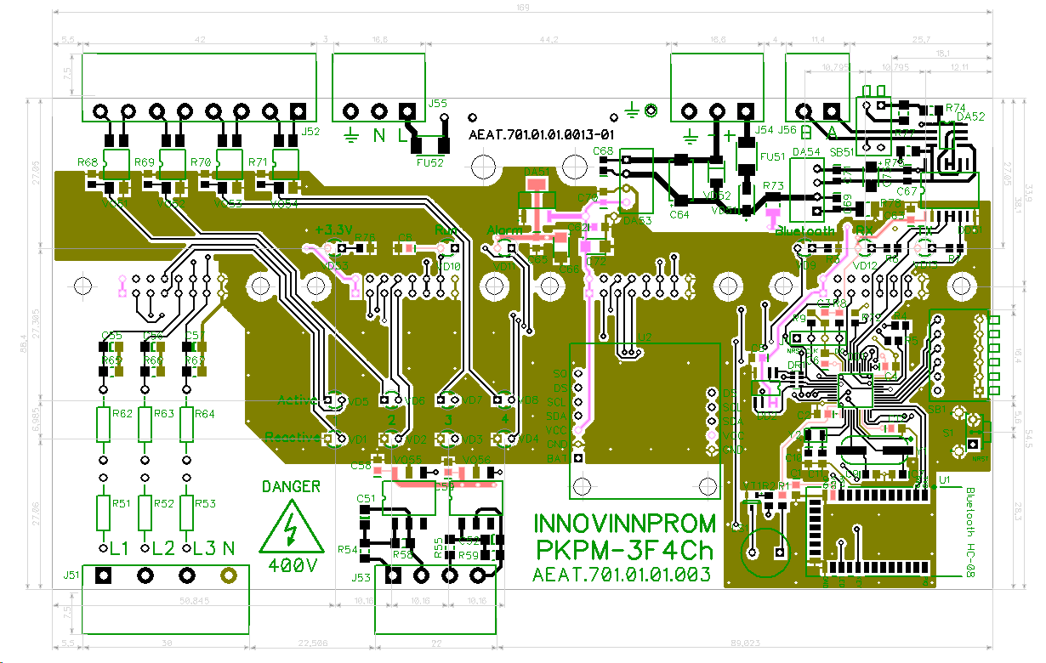
Deliverable 8:
Modernized Energy Meters
A new version of the V3.0 device has been developed, design documentation for production has been prepared.
However, due to the lack of a voucher, the devices were not manufactured. Testing was carried out using existing devices.
Reference energy meter
Power Supply
Active load
Gateway
Reactive load
Switching units
Test device
Current transformers
Notes:
Presentation of each Deliverable of Project that should have been delivered up to mid term review, what was done and how it connects to the TTE.
Презентація кожного результату проекту, який мав бути наданий до проміжного огляду, що було зроблено та як це пов’язано з TTE.
Each on separate slide
Кожен на окремому слайді

Slide 17
KPI number and name
Target value of KPI: Increasing the number of SAKURA-APM system functions from 4 to 7.
Reached value of KPI: 7
Functions 1: Energy monitoring
Functions 2: Energy efficiency
Functions 3: Maintenance and repair
Functions 4: Product control
Functions 5: AI Routing
Functions 6: Prediction of energy consumption
Functions 7: Environmental monitoring
Notes:
Presentation of each KPI of Project that should have been reached up to midterm review on separate slide , what was done, how it connects to the TTE, justification if target value was not reached
Презентація кожного KPI проекту, який мав бути досягнутий до проміжного аналізу, на окремому слайді, що було зроблено, як це пов’язано з TTE, обґрунтування, якщо цільове значення не досягнуто

Slide 18
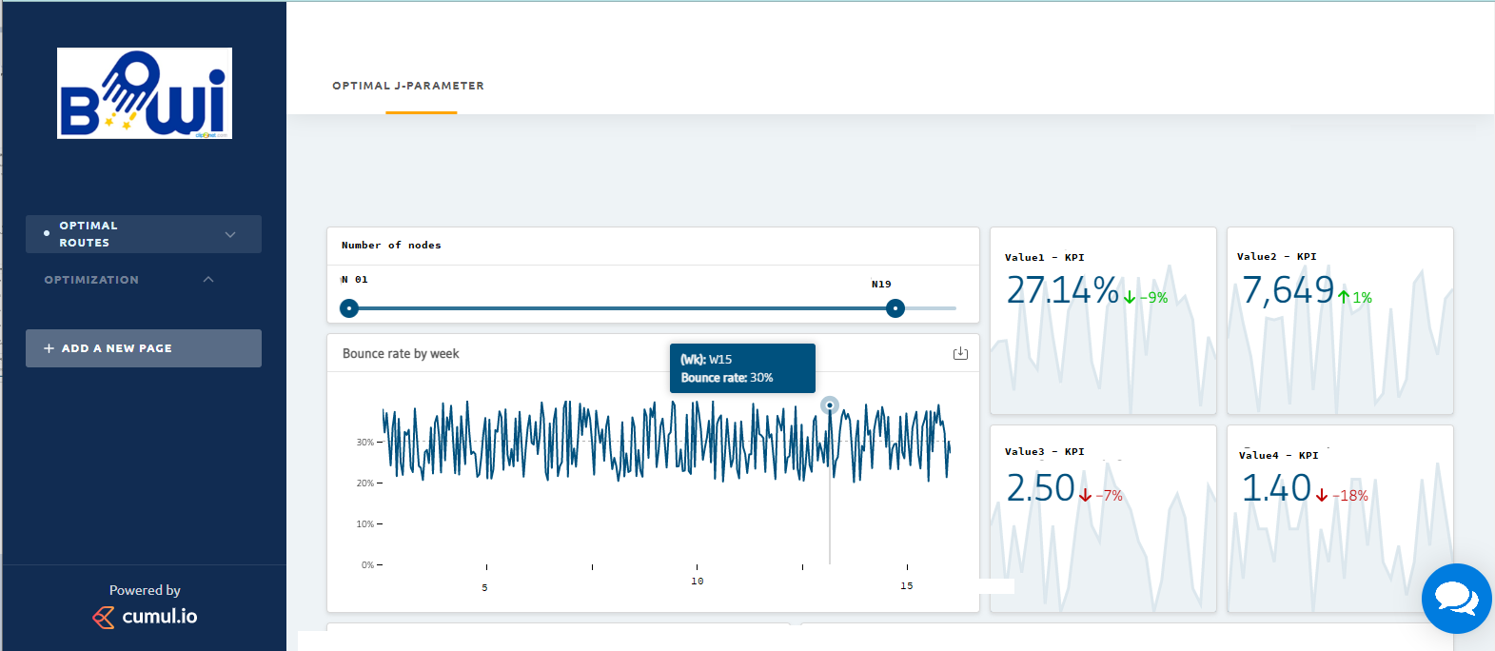
System Function 5:
Dashboard for visualizing the effectiveness of finding the optimal route with minimal energy
Dashboard allows you to display - The optimal action diagram (parameter J). Using scrolling, you can select the required number of nodes on the route. On the graph you can view the information on the relevant node.
Notes:
Presentation of each KPI of Project that should have been reached up to midterm review on separate slide , what was done, how it connects to the TTE, justification if target value was not reached
Презентація кожного KPI проекту, який мав бути досягнутий до проміжного аналізу, на окремому слайді, що було зроблено, як це пов’язано з TTE, обґрунтування, якщо цільове значення не досягнуто

Slide 19
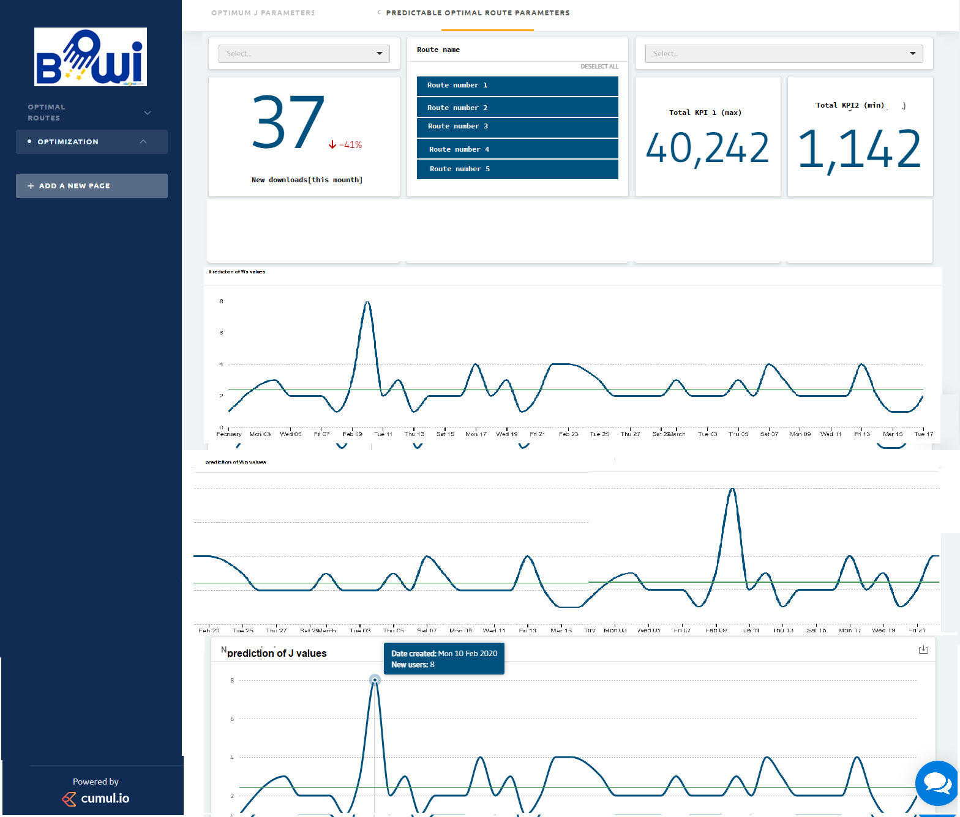
System Function 6:
Dashboard for visualization of projected energy consumption at the output of nodes of the optimal route
The dashboard allows for the selected route and node to plot the predicted values of parameters Ws, Wp, Wq and J as a function of time, information is available for each type of node concerned:
J = ksWs + kpWp + kq(Wqmax - Wq)
Notes:
Presentation of each KPI of Project that should have been reached up to midterm review on separate slide , what was done, how it connects to the TTE, justification if target value was not reached
Презентація кожного KPI проекту, який мав бути досягнутий до проміжного аналізу, на окремому слайді, що було зроблено, як це пов’язано з TTE, обґрунтування, якщо цільове значення не досягнуто

Slide 20
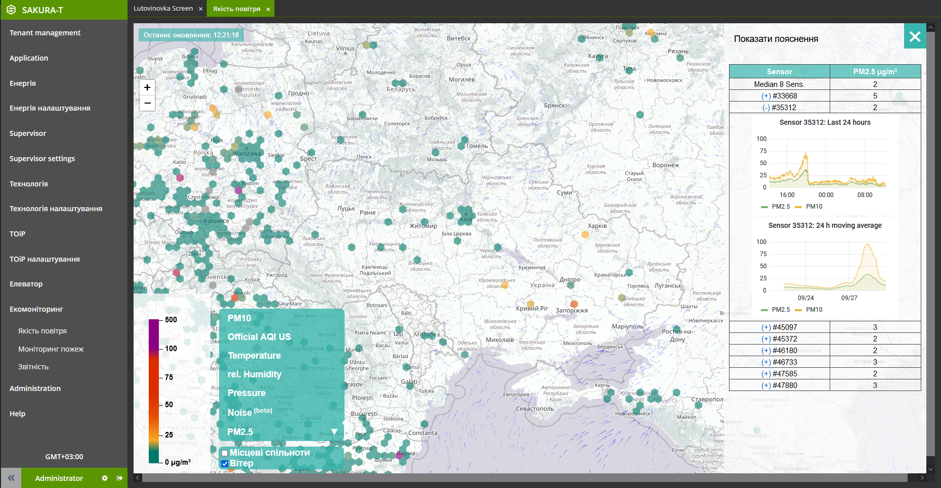
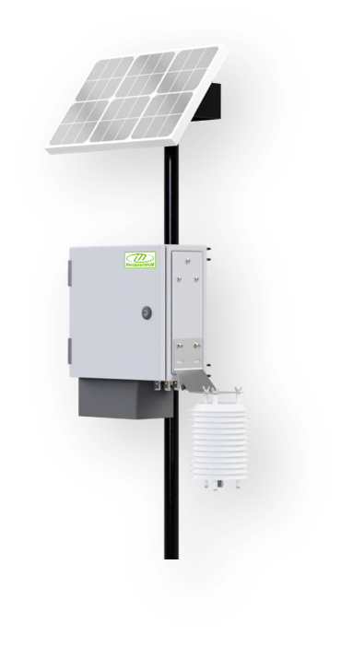
System Function 7:
Environmental monitoring function
Visualization of data received from environmental monitoring stations in the form of scalable icons
Visualization of data obtained from public environmental monitoring networks
Analytical processing of data, formation of reporting forms for the selected period
Visualization of environmental monitoring and fire data obtained from NASA satellite systems
Visualization of wind speed and direction (distribution directions of harmful substances)
Issuance of data to all-Ukrainian and European environmental monitoring systems
Providing access to public data to citizens
Data archiving and backup for the entire period of system operation
cloud.innovinnprom.com
www.eco.sakura.ms
Notes:
Presentation of each KPI of Project that should have been reached up to midterm review on separate slide , what was done, how it connects to the TTE, justification if target value was not reached
Презентація кожного KPI проекту, який мав бути досягнутий до проміжного аналізу, на окремому слайді, що було зроблено, як це пов’язано з TTE, обґрунтування, якщо цільове значення не досягнуто

Slide 21
Support from BOWI project
Many mentoring meetings from Centre 4.0 KPI DIH have been held – 9 meetings on a regular basis according to the schedule agreed in the TAR – second and fourth Tuesday of each month. Also, it should be noted support from PIAP DIH which included Technical and business consulting, TAR improvements, etc. According to the results of the meetings, SMEs received the following support from BOWI and benefit from that:
Assistance in setting up technical processes;
Technical and business consulting;
Monitoring the implementation of the project plan;
Coordination of assistance to customers and project executors;
Coordination and assistance in the preparation of the report and presentations on the project;
Organizing communications with other project participants;
Consultations on the formation and improvement of KPI.
Notes:
Discribe the support received from BOWI project
Опишіть підтримку, отриману від проекту BOWI
How many mentoring meetings from Widening hub and from Mature hub.
Скільки менторських зустрічей від Widening hub і Mature hub.

Slide 22
Budget spending
Costs | Budgeted | Actual
Personnel | 28 500,00 | 27 538,38
Travel | 0 | 0
Other | 300,00 | 0
Subcontracting | 2 000,00 | 3 030,25
Overhead | 7 125,00 | 6 884,60
Total | 37 925,00 | 37 453,23
* The decrease in personnel funds is connected with the call for mobilization of one of the leading programmers. Accordingly, in order to perform the necessary works, and due to the impossibility of quickly hiring a specialist with the necessary skills, it was necessary to conclude an additional subcontracting agreement.

Slide 23
Road Map & Team

Slide 24
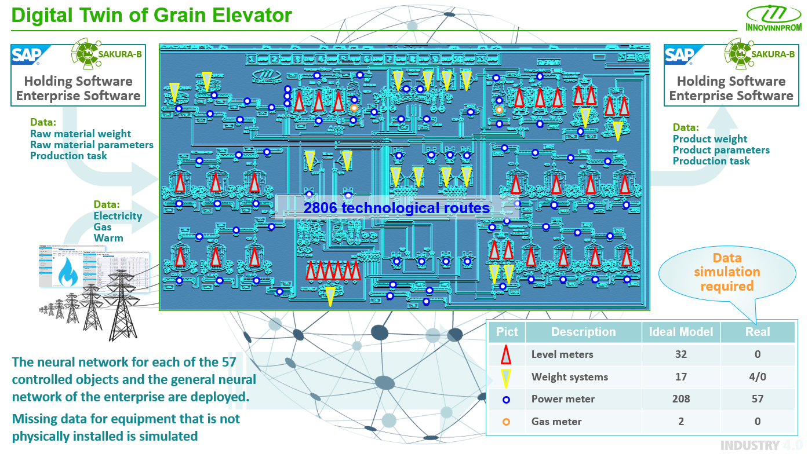
Objective 1:
Digital Twin of the Enterprise

Slide 25
Links and info
INNOVINNPROM LTD Shevchenka 5a street, Vinnytsia, Ukraine
Link to company web site: https://innovinnprom.com
Link to TTE web site: https://innovinnprom.com/galuzevi-rishennya/sakura-apm
Link to project: https://cloud.innovinnprom.com
Link to ECO web site: https://www.eco.sakura.ms/?lang=en

Slide 26
Asset Performance Management System for grain processing industry
SAKURA-APM
PaaS SAKURA-IIoT based
This project was funded from BOWI Horizon 2020 project
Notes:
Instructions
Replace yellow higlighted parts with right text, remove highlight colour
Copy additional slides to KPI explanation
Fill in the Budget table of budgeted and actual spending.
Add links to company web site and video.

Slide 27
Desire
On July 14, 2022, project manager Andriy Lukhverchyk was hit by Russian missiles in the Vinnytsia.
As a result of the explosions, two work laptops, his own car and property were lost. Fortunately, the injury was minor.
Andriy gave his own laptop to the victims of Russian aggression. His family, who lived in the city of Borodyanka, lost their home as a result of an aerial attack by the Russian invaders.
Please allow to change the project budget and allow the purchase of a laptop.

