Slide 1
SAKURA-APM
Final Report 3.rd O.C. for TTE’s
INNOVINNPROM
Andrii Lukhverchyk
Centre 4.0 KPI DIH
DIH PIAP

Slide 2
Executive summary of TTE
The support of BOVI helped us achieve the following results :
Keep the team and continue working against the background of a significant economic downturn.
Significantly optimize the technology stack
Update the version and add new features to the system software.
Develop new version and upgrade SCADA and PLC software.
Obtain and analyze large arrays of grain elevator equipment operation data.
Select and test algorithms for the use of neural networks.
Conduct experiments on the use of artificial intelligence to optimize the efficiency of technological processes.
Many mentoring meetings from Centre 4.0 KPI DIH have been held. As a result, SMEs are fully satisfied with the received support which included assistance in setting up technical processes, technical and business consulting, etc. PIAP DIH helped a lot during TTE planning with technical and business advices.

Slide 3
Deliverable D1 Requirements Specification
Software specification
№ | Component | Amount
1 | CAD Route InnoVinnprom 2.0.17 | 1 lic
2 | Java 11.0.15 | 1 lic
3 | NodeJS 16.15.1 | 1 lic
4 | React 16.13.1 | 1 lic
5 | Bootstrap 4.6 | 1 lic
6 | Grafana 7.1.15 | 1 lic
7 | Guacamole 1.1.0 or MeshCentral 0.9.61 | 1 lic
8 | PostgreSQL 14.4 with TimescaleDB 2.7 | 1 lic
9 | Spring boot 2.6 | 1 lic
10 | Python 3 | 1 lic
11 | Google Collab | 1 lic
12 | PyTorch 1.11.0 | 1 lic
13 | Traefik 2.7 | 1 lic
14 | Rabbitmq 3.8 | 1 lic
15 | Hazelcast 5.1.4 | 1 lic
16 | Sonarqube 9.6.0 | 1 lic
17 | Prometheus 2.38.0 | 1 lic
The list of equipment and software application for TTE purposes has been created and discussed with TiR. The list includes hardware for data gathering and transfer, software IDEs and applications useful for TTE implementation.
Hardware specification
№ | Component | Amount
1 | Gateway Teltonika RUT955 / RUT956 | 3 + 1
2 | Power Meter INNOVINNPROM PKZM-3Pf4Ch | 17
Notes:
Перелік обладнання та програмного забезпечення для цілей TTE було створено та обговорено з TiR.
Список включає апаратне забезпечення для збору та передачі даних, програмні IDE та програми, корисні для реалізації TTE

Slide 4
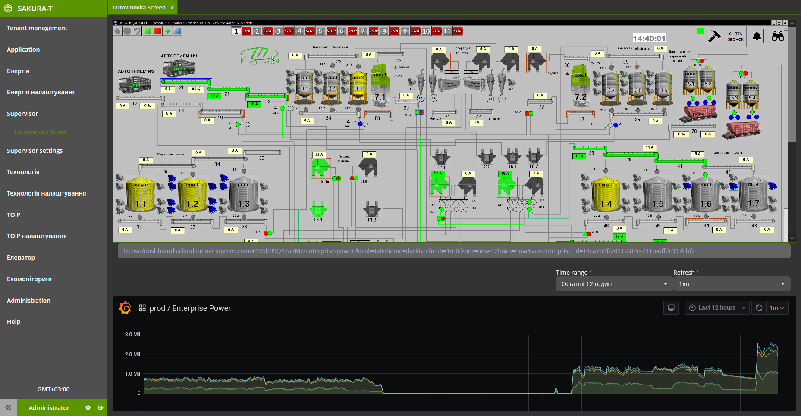
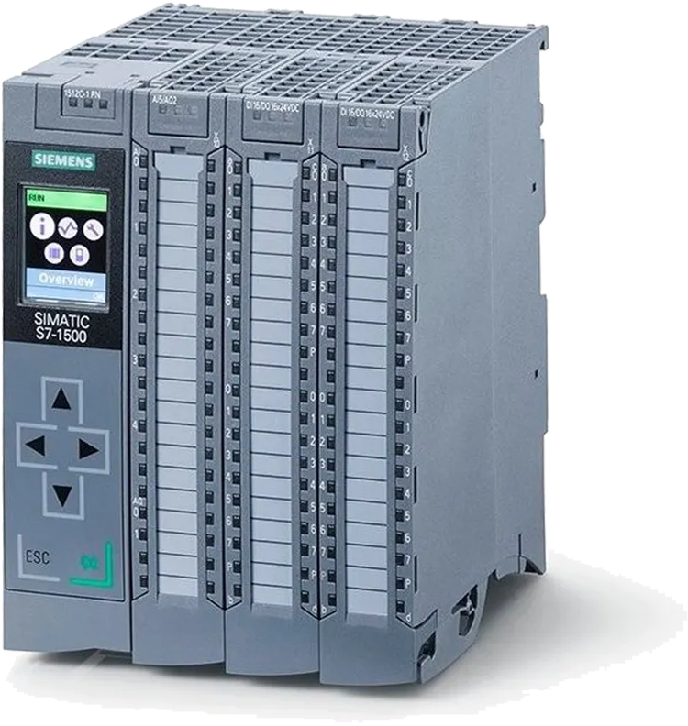
Deliverable D2.1 New Version of SCADA Software
Add support for SCADA for export data for creating Digital Twin.
Added support for the ID of each operation and each technological route.
Implemented Ukrainian-language interface
Development of a new version of the PLC firmware.

Slide 5
Deliverable D2.2 Digital Twin Production

Slide 6
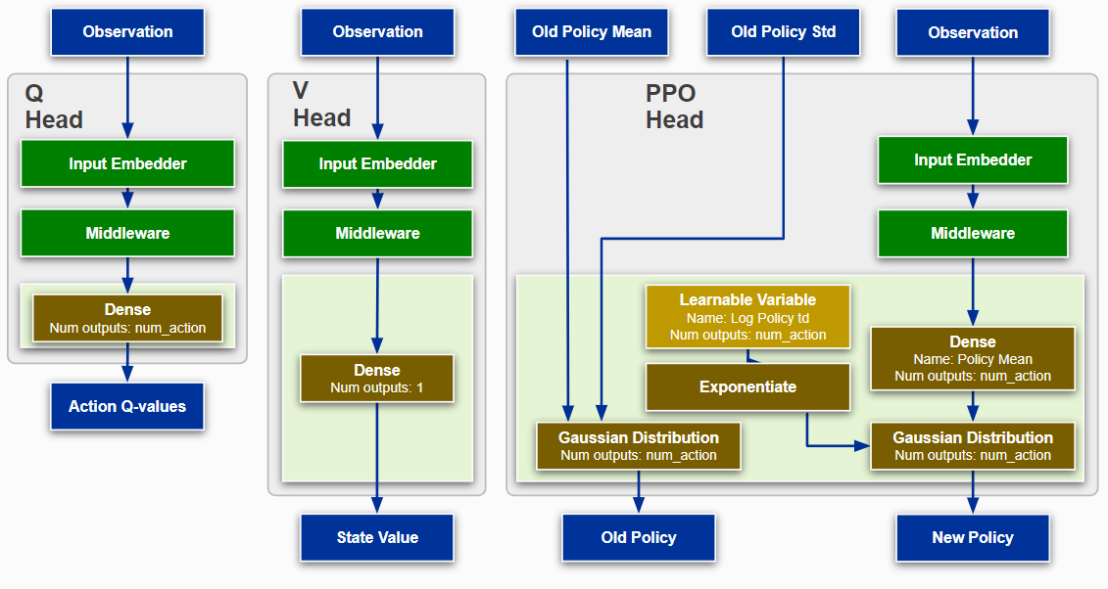
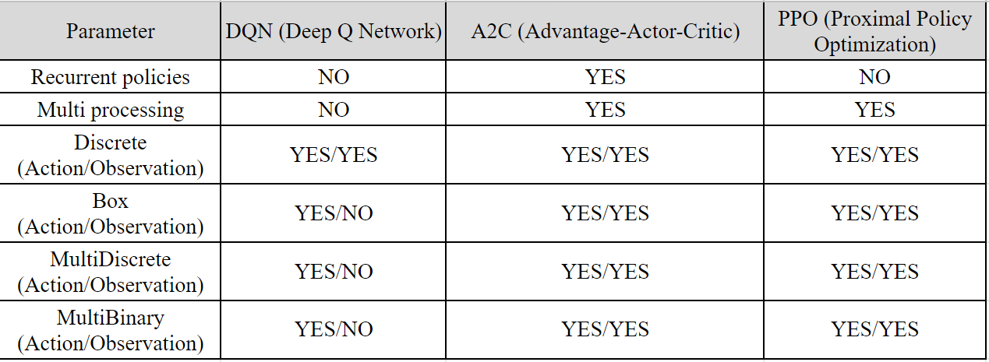
Deliverable D2.3 Analysis of analogues for the optimization of the TP using intelligent information technology
Block diagram DQN
Block diagram PPO
Comparative table of analogues for the optimization of the TP using intelligent information technology
The best option is intellectual method A2C with reinforcement learning

Slide 7
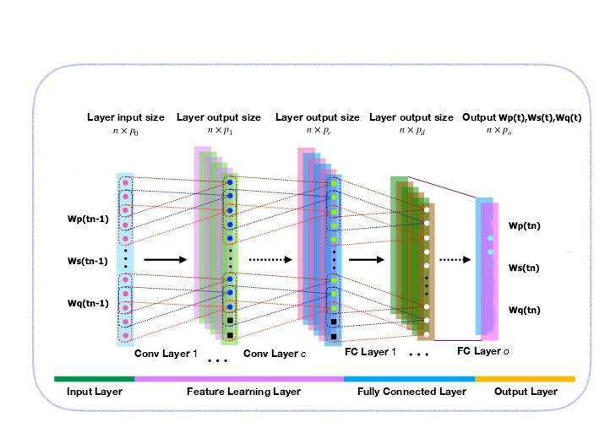
Deliverable D2.4 Architecture neural networks of typical nodes of grain elevator route devices: option 1
Prediction of three output parameters at once based on the same three input parameters, the same outputs of the previous node at the previous moment in time by one convolutional neural network (CNN) with a complex architecture CNN model

Slide 8
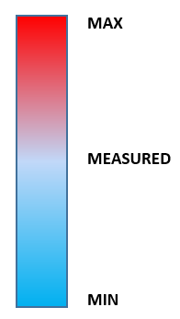
Deliverable D2.5 Planning of experiments necessary for training of neural network models of nodal devices and system as a whole
At the experimental stage, data from stage 1 of our intellectual technology will be taken and the implementation of stages 2 and 3 will be simulated - as if only the input parameters are known. The result will be compared with the measured values. The other 2 experiments will concern much larger and much smaller parameter values ​​with a larger and smaller load (for example, more moist and dense and vice versa) to check how the algorithm will behave in extreme conditions.
SYSTEM
Ws,Wp,Wq
Notes:
На експериментальному етапі будуть взяті дані з етапу 1 нашої інтелектуальної технології та змодельована реалізація етапів 2 і 3 - ніби відомі лише вхідні параметри. Результат буде порівняно з виміряними значеннями. Інші 2 експерименти стосуватимуться набагато більших і набагато менших значень параметрів з більшим і меншим навантаженням (наприклад, більш вологим і щільним і навпаки), щоб перевірити, як алгоритм поводитиметься в екстремальних умовах.

Slide 9
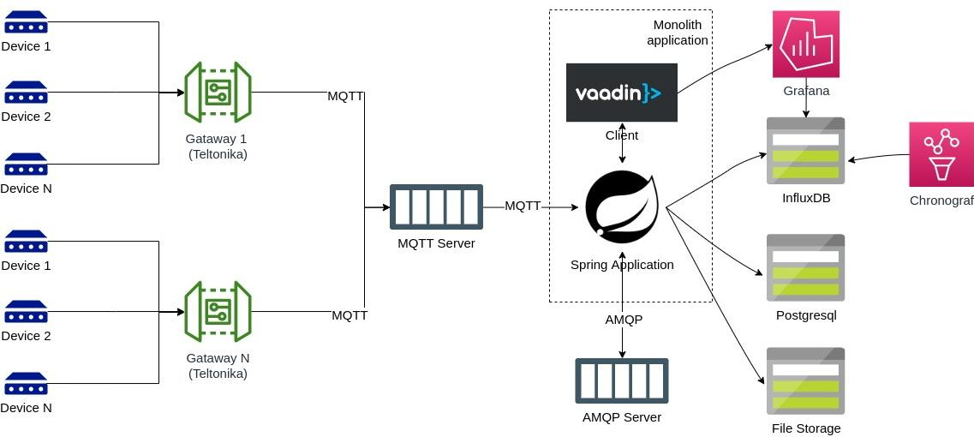
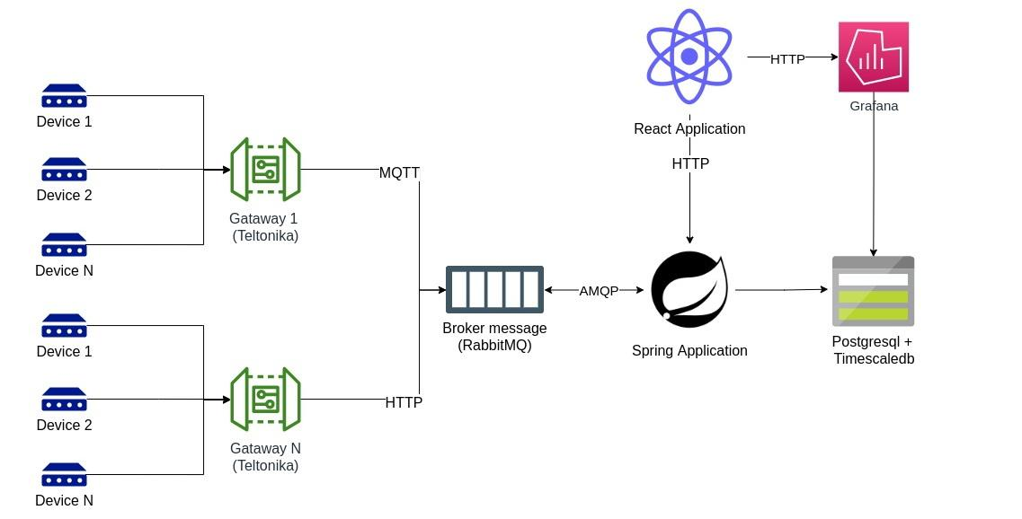
Deliverable D2.6 Optimize the Technology Stack
The monolithic application was divided into a client and a server.
Moved the client part from Vaadin to React. This provides more opportunities for development, simplifies maintenance, allows for easier configuration of horizontal scaling.
Due to the TimescaleDB extension for PostgreSQL, we excluded the time series database (Influxdb) and the administration tool (Chronograf).
Moved the Mqtt server to RabbitMQ, due to the Rabbit-MQTT plugin.
PostgreSQL is used to store files.
We increased the fault tolerance of the application due to the introduction of a two-way queue in RabbitMQ.

Slide 10
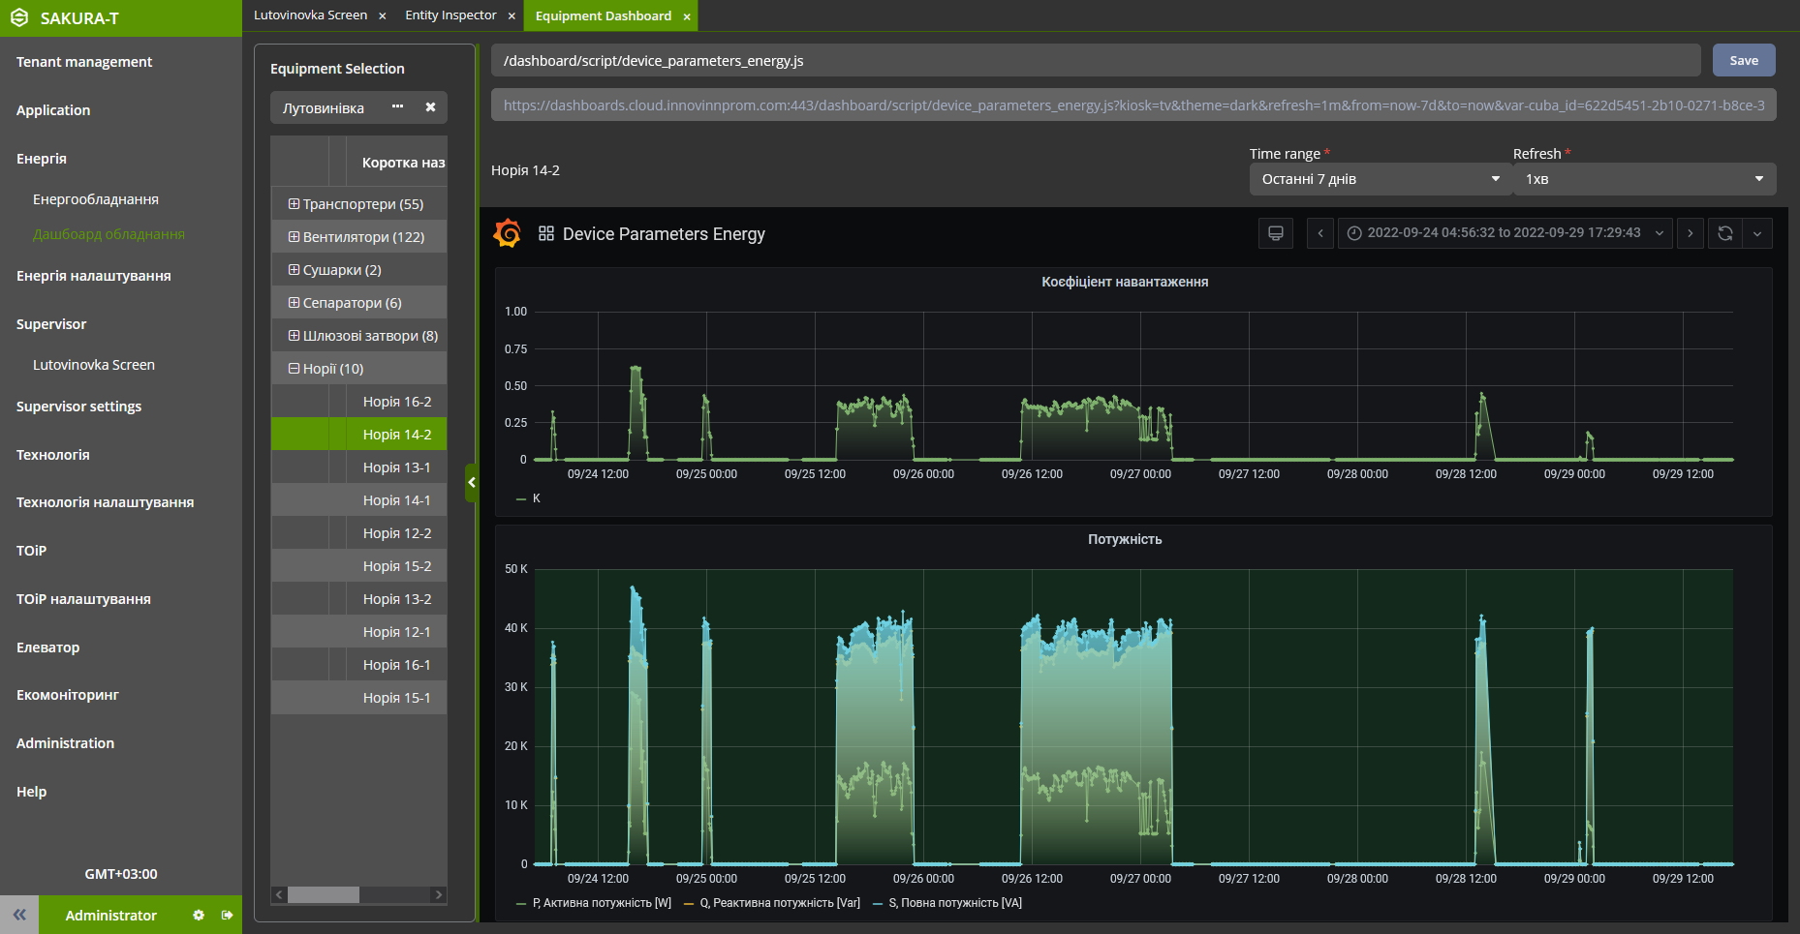
Deliverable D2.7 New Version of System Software
Added support of application localization. Added English locale.
Added dark theme to web interface of the system.
The structure of the menu and interface windows has been changed.

Slide 11
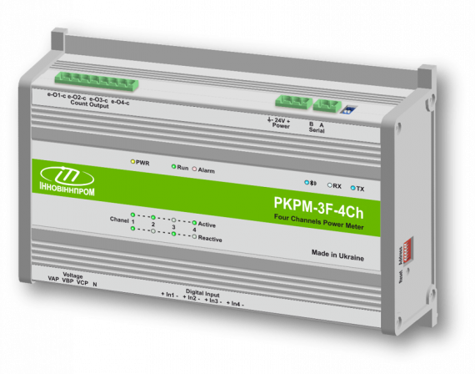
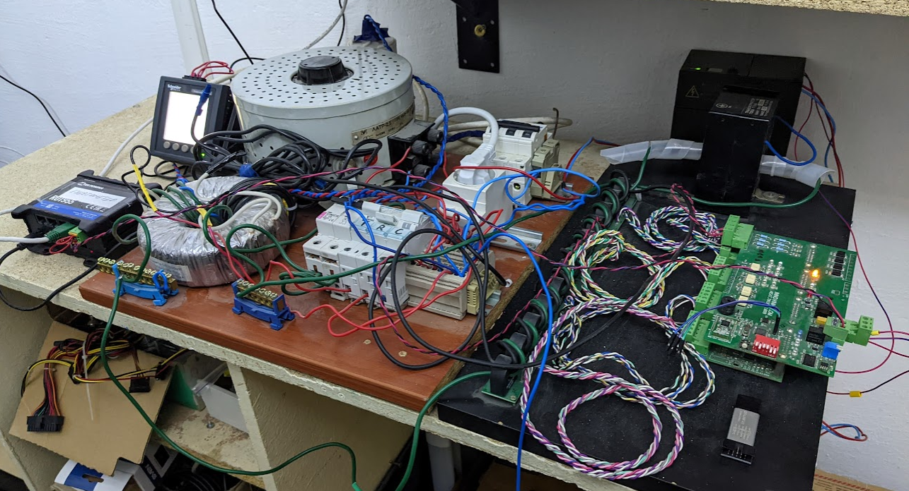
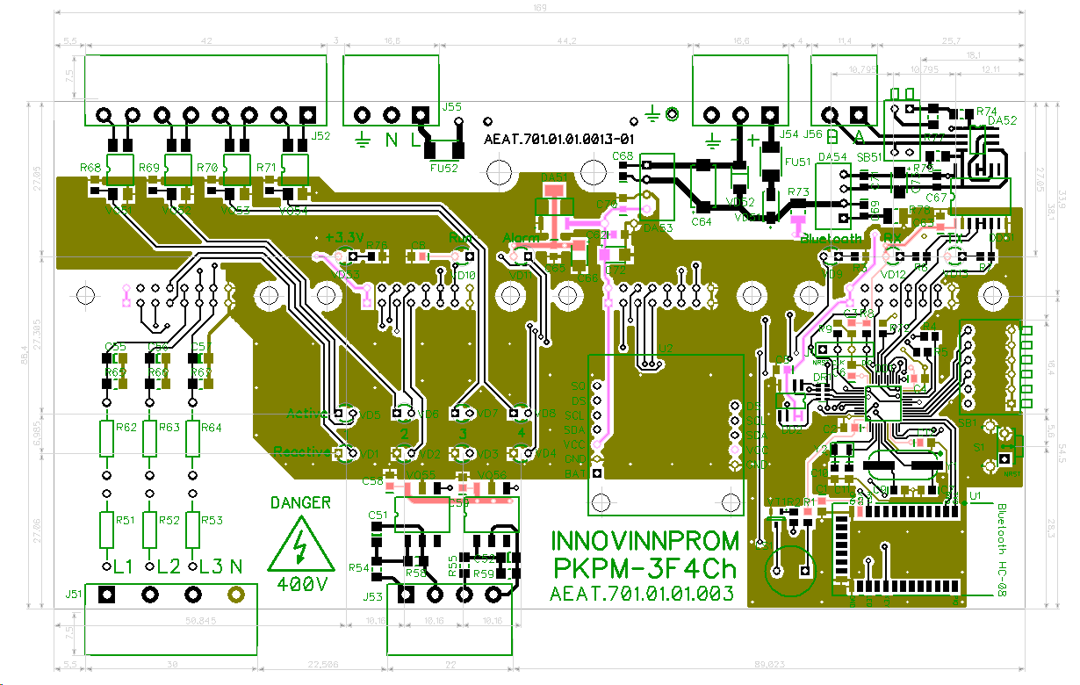
Deliverable D2.8 Modernized Energy Meters
A new version of the V3.0 device has been developed, and design documentation for production has been prepared.
Reference energy meter
Power Supply
Active load
Gateway
Reactive load
Switching units
Test device
Current transformers

Slide 12
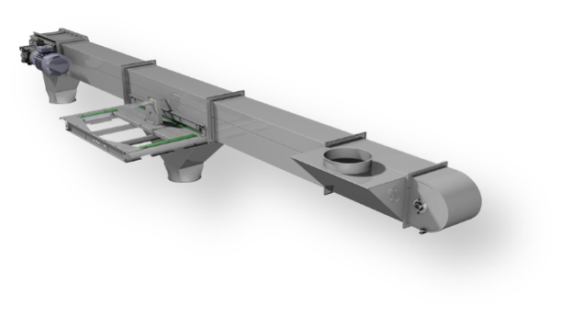
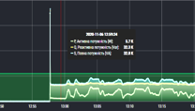
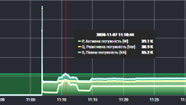
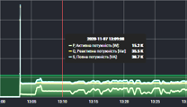
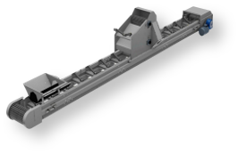
Deliverable D3.1 Data sources for the AI module
Technological route
horizontal conveyor
Eq.3
Route operating time
The procedure for turning on the equipment
Technological delay
Technological delay
Direction of movement of products
Eq.1
Eq.2
Eq.3
The procedure for turning on the equipment
Eq.2
noria
Power-on time
Three-phase voltage
Three-phase current
Power factor (cos φ)
Active, reactive, full power
Active, reactive, full energy
Time out
Product
Bearing temperature
Status of the sensors
Term of work
Term of maintenance
Season
Time of day
Work shift
Power-on time
Three-phase voltage
Three-phase current
Power factor (cos φ)
Active, reactive, full power
Active, reactive, full energy
Time out
Product
Bearing temperature
Status of the sensors
Term of work
Term of maintenance
Season
Time of day
Work shift
Power-on time
Three-phase voltage
Three-phase current
Power factor (cos φ)
Active, reactive, full power
Active, reactive, full energy
Time out
Product
Bearing temperature
Status of the sensors
Term of work
Term of maintenance
Season
Time of day
Work shift
Route operating time
Power-on time
Active, reactive, full energy
Time out
Product
Season
Time of day
Work shift
horizontal conveyor
Eq.1
Direction of movement of products
The equipment involved in the route is turned on starting from the last device, turned off starting from the first device

Slide 13
Deliverable D3.2 Generated data for the AI module
Real-time table of energy parameters energy_20хх_хх.zip
name | time | equipment _id | Ua | Ub | Uc | Wp | Wq | Ws | Pp | Pq | Ps | cosA | cosB | cosC | Ia | Ib | Ic | Umax | Imax
name | time | equipment_id |  |  |  |  |  | Ws |  |  | Ps
Energy data is provided for each unit of equipment with a discreteness of 1s in real time. They provide a complete picture of the quality and efficiency of the equipment.
Route statistics table route_history.csv
route_id | start_date | stop_date | route | variant_route
Table of equipment parameters equipments.csv
equipment_id | full_name_equipment | short_name_equipment | name_equipment_type | nominal_power
Equipment statistics table in routes equipment_in_route_history.csv
equipment_id | route_id | postition
Notes:
Brief overview what was done and what was reached up to midterm review.
Короткий огляд того, що було зроблено та чого досягнуто до проміжного огляду.

Slide 14
Deliverable D3.3 Data preparation for the AI module
Table 2
route_history.csv
Table 4
equipment_in_route_history.csv
Table 1
energy_20хх_хх.zip
Information about Route
Information about Equipment en route
Information about Equipment parameters
Real-time parameters of the equipment unit:
Incremental energy value of the Ws
Instantaneous power value of the Ps
Instantaneous value of the cos φ
The rest of the equipment data
The data in table No. 3 are used to forecast the energy consumption of routes for which there are no statistical data
Notes:
Brief overview what was done and what was reached up to midterm review.
Короткий огляд того, що було зроблено та чого досягнуто до проміжного огляду.

Slide 15
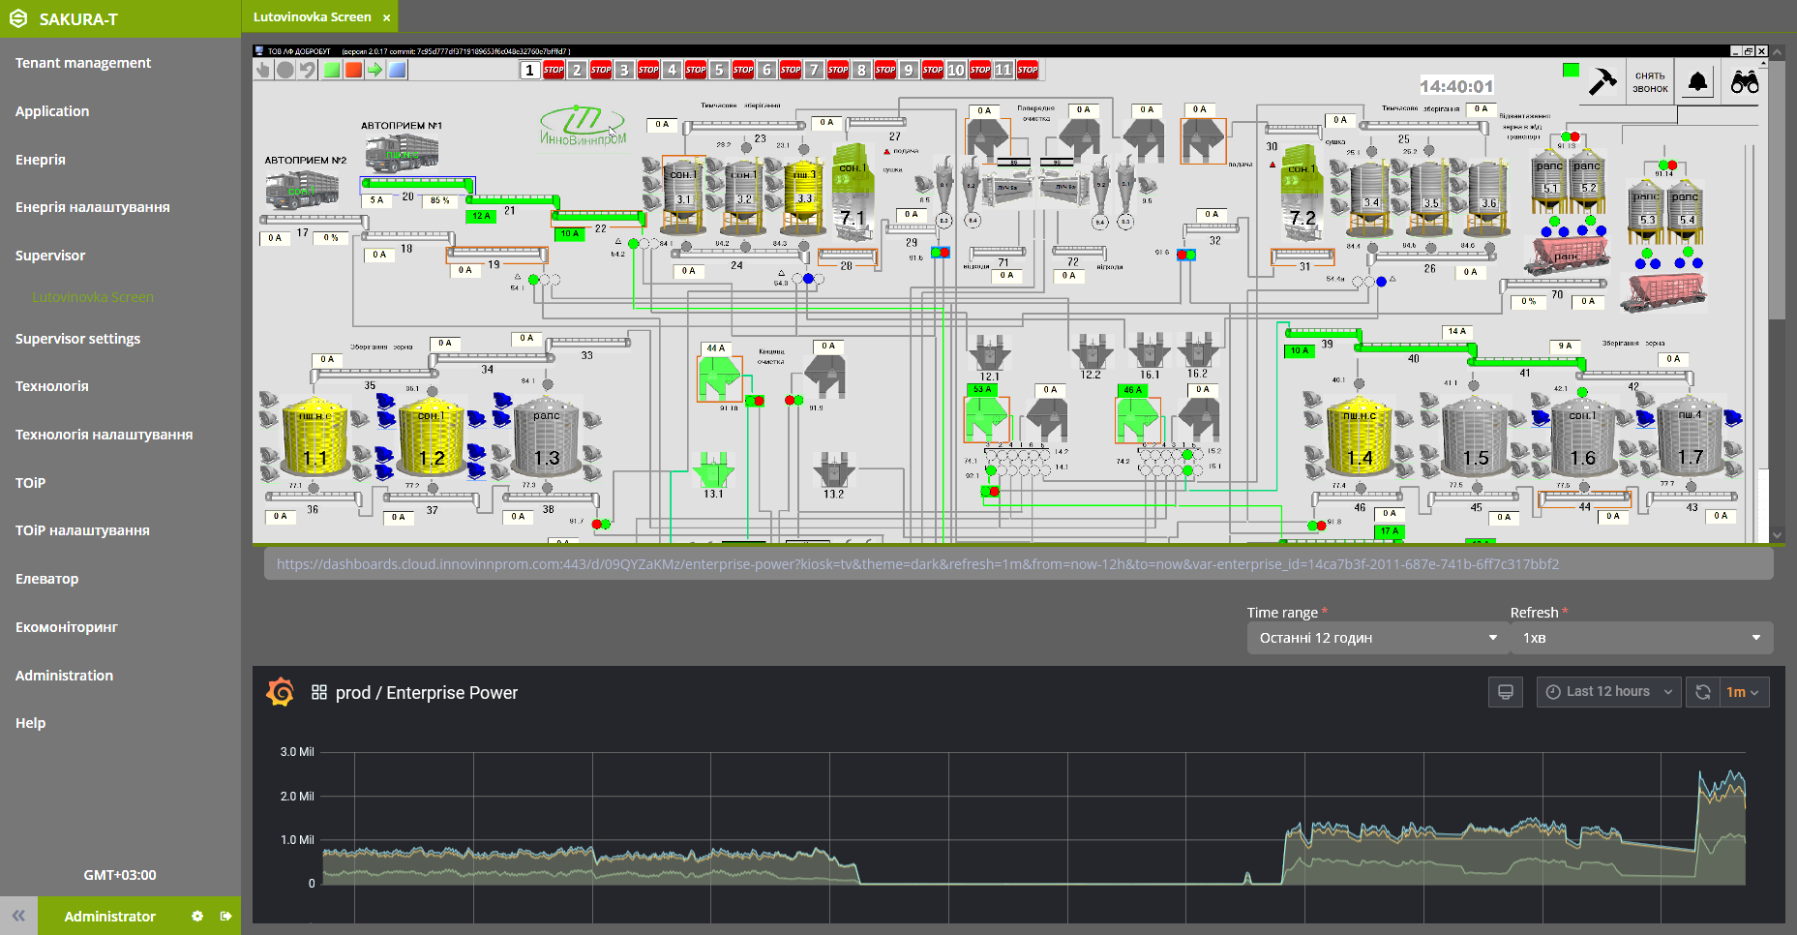
Deliverable D3.4 Choice of information technology for optimization of production at the grain elevator
Routes with CNN model for each node
N - number of routes
T - duration of calculations for optimization
Route 1, Node 1 … Route 1, Node M
Option 1.
IT for optimization of routes with RL
Option of IT | N | T
1 | Small | Middle
2 | Small | Big
3 | Small | Small - optimal
1 | Big | Small - optimal
2 | Big | Big
3 | Big | Middle
…
Route N, Node 1 … Route N, Node M
…
Option 2. Calculation output of all models
DATA
Routes with CNN model for each route
Route 1
Option 3. Calculation output of all models
Route N
Experiments showed that under real conditions, in most cases, the number of possible combinations of route variations between given input and output bunkers is small, so it was decided to implement option 3.
It was option 3 that ensured the optimal duration of calculations, which is important for the operator
Notes:
Експерименти показали, що в реальних умовах у більшості випадків кількість можливих комбінацій варіацій маршруту між заданими вхідними та вихідними бункерами невелика, тому було вирішено реалізувати варіант 3.
Саме варіант 3 забезпечив оптимальну тривалість обчислень, що важливо для оператора

Slide 16
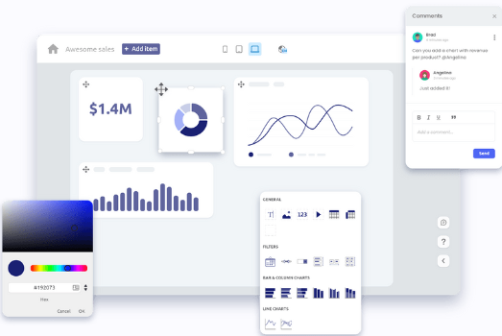
Deliverable D3.6 Construction of intelligent simulator for simulation and visualization of the grain elevator technological cycle and optimization of its routes and equipment parameters
Module of the SAKURA with Information Toolbox of the Intellectual IT for Grain Elevator Optimization
Pretrained Models Bank
Notes:
Brief overview what was done and what was reached up to midterm review.
Короткий огляд того, що було зроблено та чого досягнуто до проміжного огляду.

Slide 17
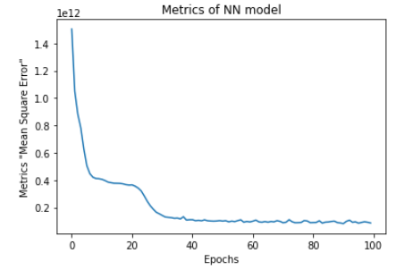
Deliverable D3.5 Creating trained neural network model for grain elevator route based on real data
ML of NN model:
NN Regressor predicting:
Layer (type) Output Shape Param #
==================================================
dense (Dense) (None, 256) 1280
__________________________________________________
dense_1 (Dense) (None, 128) 32896
__________________________________________________
dense_2 (Dense) (None, 64) 8256
__________________________________________________
dense_3 (Dense) (None, 32) 2080
__________________________________________________
dense_4 (Dense) (None, 3) 99
==================================================
Total params: 44,611
Metrics of NN model:
Accuracy:
Route 0 prediction
Wp_n Relative error: 9.646%
Wp_n r2score : 0.8129453521752672
_________________________________________
Route 1 prediction
Wq_n Relative error: 9.425%
Wq_n r2score : 0.8476444593901902 _________________________________________
Route 2 prediction
Ws_n Relative error: 9.447%
Ws_n r2score : 0.8420825194985004
60 % Training | 20 % Validation | 20 % Testing
Notes:
Brief overview what was done and what was reached up to midterm review.
Короткий огляд того, що було зроблено та чого досягнуто до проміжного огляду.

Slide 18
Deliverable D3.7 Construction of algorithms for optimizing grain elevator routes based on new data using machine learning technologies with reinforcement
Stage 1
Creation of the Pretrained Models Bank
Stage 2
The main stage of system operation
Retrospective data
Retrospective data
-
Is N large?
-
Is N large?
+
1 … N
+
Building route models
Building node models
Improving models
Optimization using RL
Output forecasting by models
Is the accuracy acceptable?
-
Route optimization
Visualization of optimal route
+
Saving to the bank
of pre-trained models
(BPTM)
Notes:
Brief overview what was done and what was reached up to midterm review.
Короткий огляд того, що було зроблено та чого досягнуто до проміжного огляду.

Slide 19
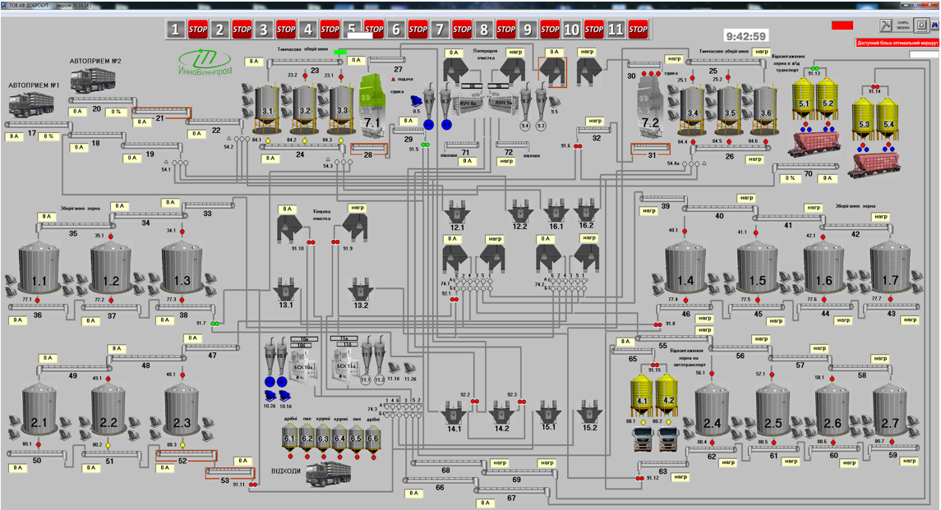
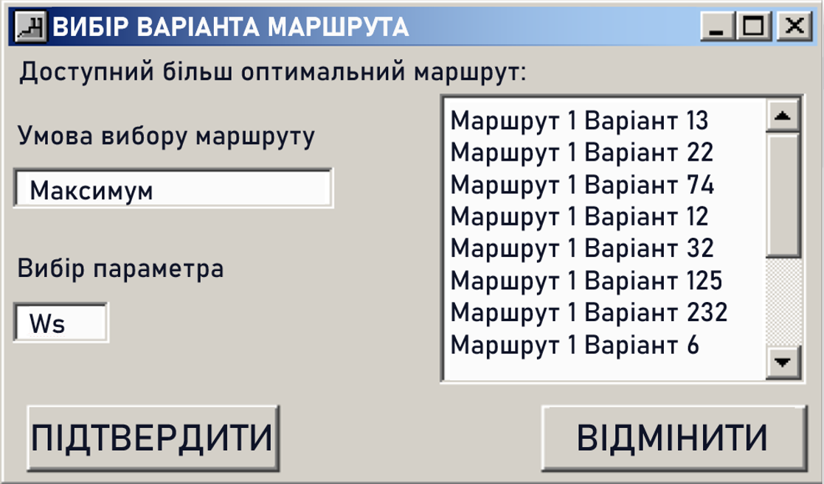
Deliverable D3.8 Selection of the optimal routes using intelligent simulator
НЕОПТИМАЛЬНИЙ МАРШРУТ
The menu for selecting routes and options, configuring the search for optimal routes
For the convenience of the personnel, we have left the SCADA interface familiar to elevator operators unchanged. Only in the upper right corner was added a menu for choosing the optimal route (route option).
Notes:
Для зручності персоналу ми залишили без змін звичний для операторів елеваторів інтерфейс SCADA. Лише в правому верхньому куті додано меню вибору оптимального маршруту (варіанта маршруту).
У верхньому правому куті робочого вікна є кнопка. Якщо оператор вибрав оптимальний маршрут, то він забарвлюється зеленим кольором, якщо ні – то червоним. Він клацає по ньому, а потім з’являється вікно з рекомендацією найкращого маршруту та його параметрами: Wp, Wq, Ws і cos φ

Slide 20
Deliverable D3.9 Implementation of algorithms for automatic detection of devices that may require repair, calibration, downtime, etc.
Real data
After each completion of the movement of the grain along the route, the forecast of the output data is compared with the same data at the output of the route that was selected.
Depending on the result of the comparison, a certain algorithm makes a conclusion about whether it is worth updating the models of the devices or the route and whether it is worth checking which devices of this route may require repair, calibration, downtime
Predicting data pre-trained models
Are there any significant deviations between the forecast reality?
-
Device models work normally
+
Are there many such deviations?
-
Devices that may require repair, calibration, downtime
+
The model needs to be updated
Notes:
Brief overview what was done and what was reached up to midterm review.
Короткий огляд того, що було зроблено та чого досягнуто до проміжного огляду.

Slide 21
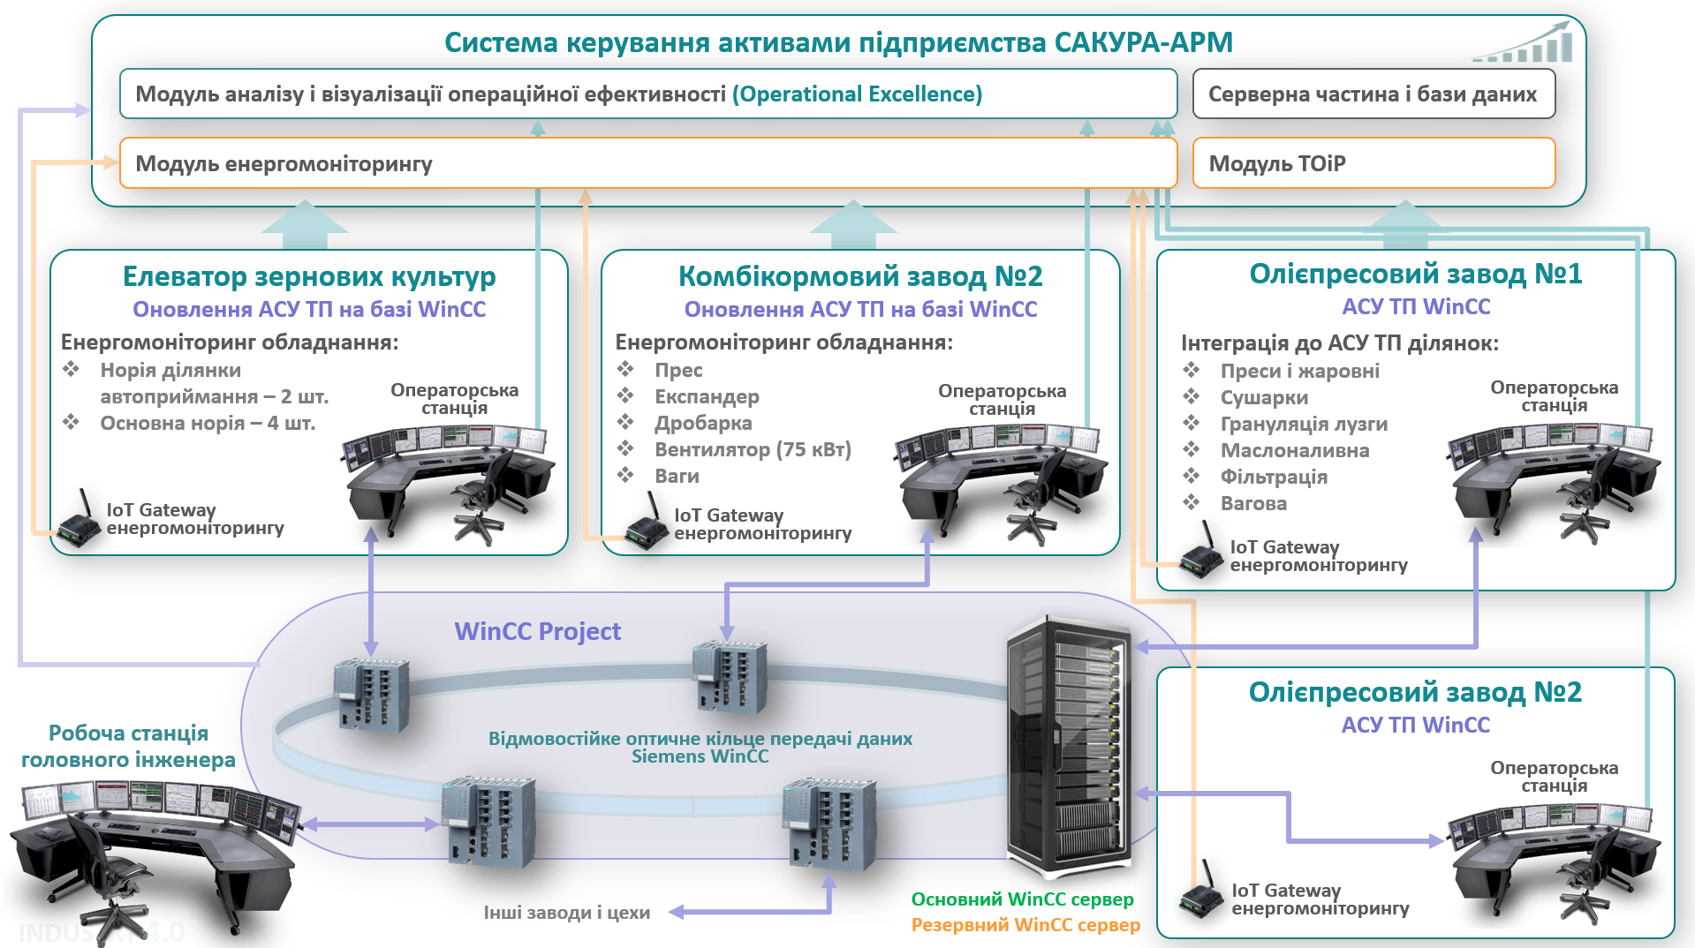
Deliverable D5.1 Implementation Plan
In the course of the project, an Implementation Plan for the implementation of the
SAKURA-APM system at the complex of enterprises of the agro-industrial holding was developed.

Slide 22
Features of KPI calculation
During the operation and development of SAKURA-APM, we received more than 100GB of data per second on the operation of 76 units of grain elevator equipment (three-phase voltage, current & power factor (cos φ), active, reactive & full power, active, reactive & full energy, power time on/off, crop, …)
In addition, practical experiments and work with data were carried out within the following limitations::
Seasonality of elevator operation - certain routes and equipment operate in a certain season.
The problem of choosing a route from a deterministic list of 11 routes, each of which has from 85 to 435 options (a total of 2,795 variations), as well as the possibility of constructing unforeseen SCADA routes (tens of thousands of variations).
Lack of possibility to work with closed commercial data on the type and weight of grain crops.
The impossibility of achieving an instant result, and the need for long-term research, which is a consequence of the need to move large volumes of grain.
The impossibility of interrupting the scheduled business processes of the elevator.
The cost of one experiment on moving grain is measured in tens of thousands of euros; the cost of an unsuccessful experiment, which can lead to a loss of grain quality or a long stoppage of the elevator, for example, due to an overflow of the noria and a break of the noria belt, can exceed the cost of grant funding.
Therefore, to assess the achieved KPIs, we compared the data obtained for the period October 2021 - January 2022 with the data obtained for the period October 2022 - January 2023. In this way, we received two huge tables with data that allowed us to conduct some analysis of the results of the work. We calculated data on the weight of the product based on the calculation of the load factor of each unit of equipment in accordance with the conducted experiments on measuring the dependence of the load factor of the equipment on the real weight of the product.
Notes:
За час функціонування і розвитку САКУРА-АПМ ми отримали більше 100Гб щосекундних даних про роботу 76 одиниць обладнання зернового елеватора (three-phase voltage, current & power factor (cos φ), active, reactive & full power, active, reactive & full energy, power time on/off, crop, …)
Окрім того, практичні експерименти і робота з даними проводилася в межах наступних обмежень:
Сезонність роботи елеватора – в певний сезон працюють певні маршрути і обладнання.
Проблема вибору маршруту із детермінованого списку в 11 маршрутів, кожен з яких має від 85 до 435 варіантів (разом 2 795 варіацій), а також можливість побудови непередбачених СКАДА маршрутів (десятки тисяч варіацій).
Відсутність можливості роботи з закритими комерційними даними щодо типу і ваги зернових культур.
Неможливість досягнення миттєвого результату, а необхідність проведення довготривалих досліджень яка є наслідком потреби переміщення великих об'ємів зерна.
Неможливість перервати планові бізнес процеси елеватора.
Вартість одного експерименту з переміщення зерна вимірюється десятками тисяч євро, вартість невдалого експерименту, який може призвести до втрати якості зерна або тривалої зупинки елеватора, наприклад, внаслідок переповнення норії і обриву стрічки норії, може перевищувати вартість грантового фінансування.
Тому для оцінки досягнутих KPI ми порівнювали дані отримані за період жовтень 2020 року – січень 2021 року з даними отриманими за період жовтень 2022 року – січень 2023 року. Таким чином ми отримали дві величезні таблиці з даними, які дозволили нам провести певну аналітику результатів роботи. Дані щодо ваги продукту ми розраховували виходячи з перерахунку коефіцієнту навантаження кожної одиниці обладнання у відповідності до проведених експериментів щодо вимірювання залежності коефіцієнту навантаження обладнання від реальної маси продукту.

Slide 23
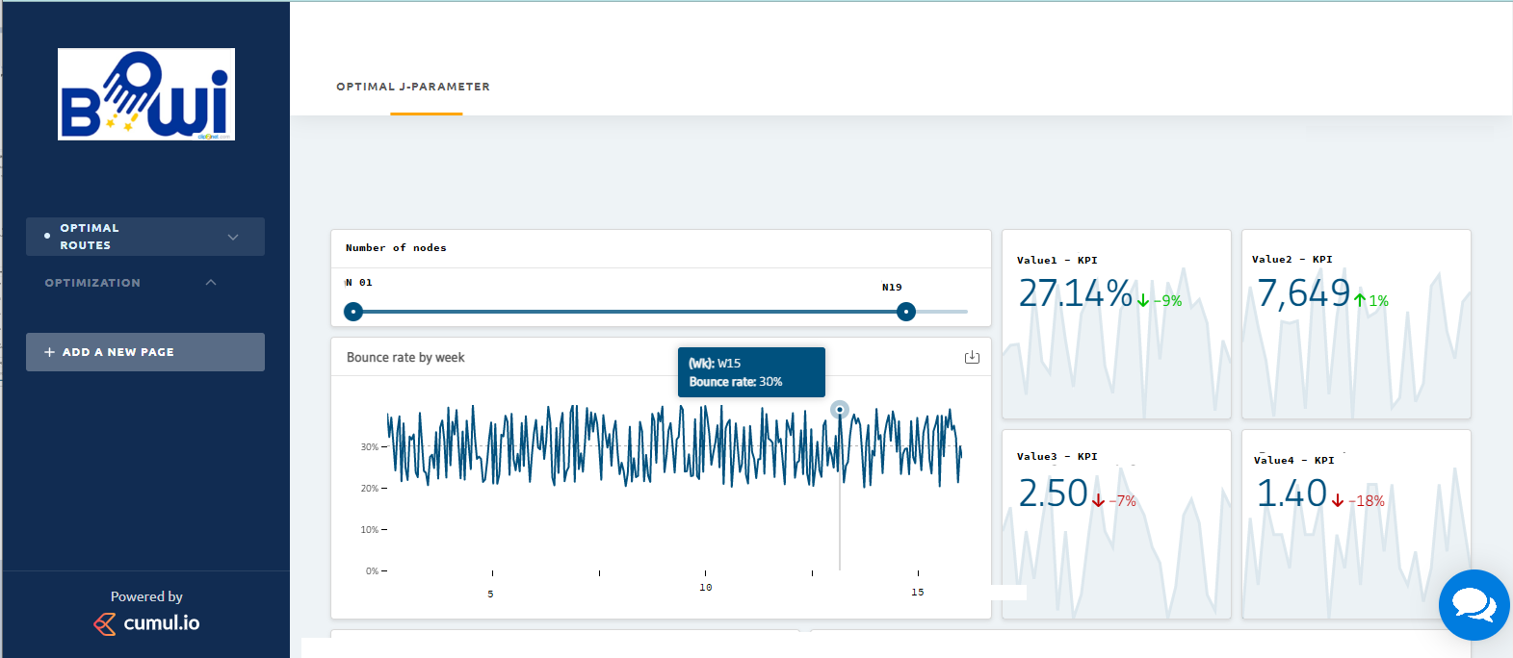
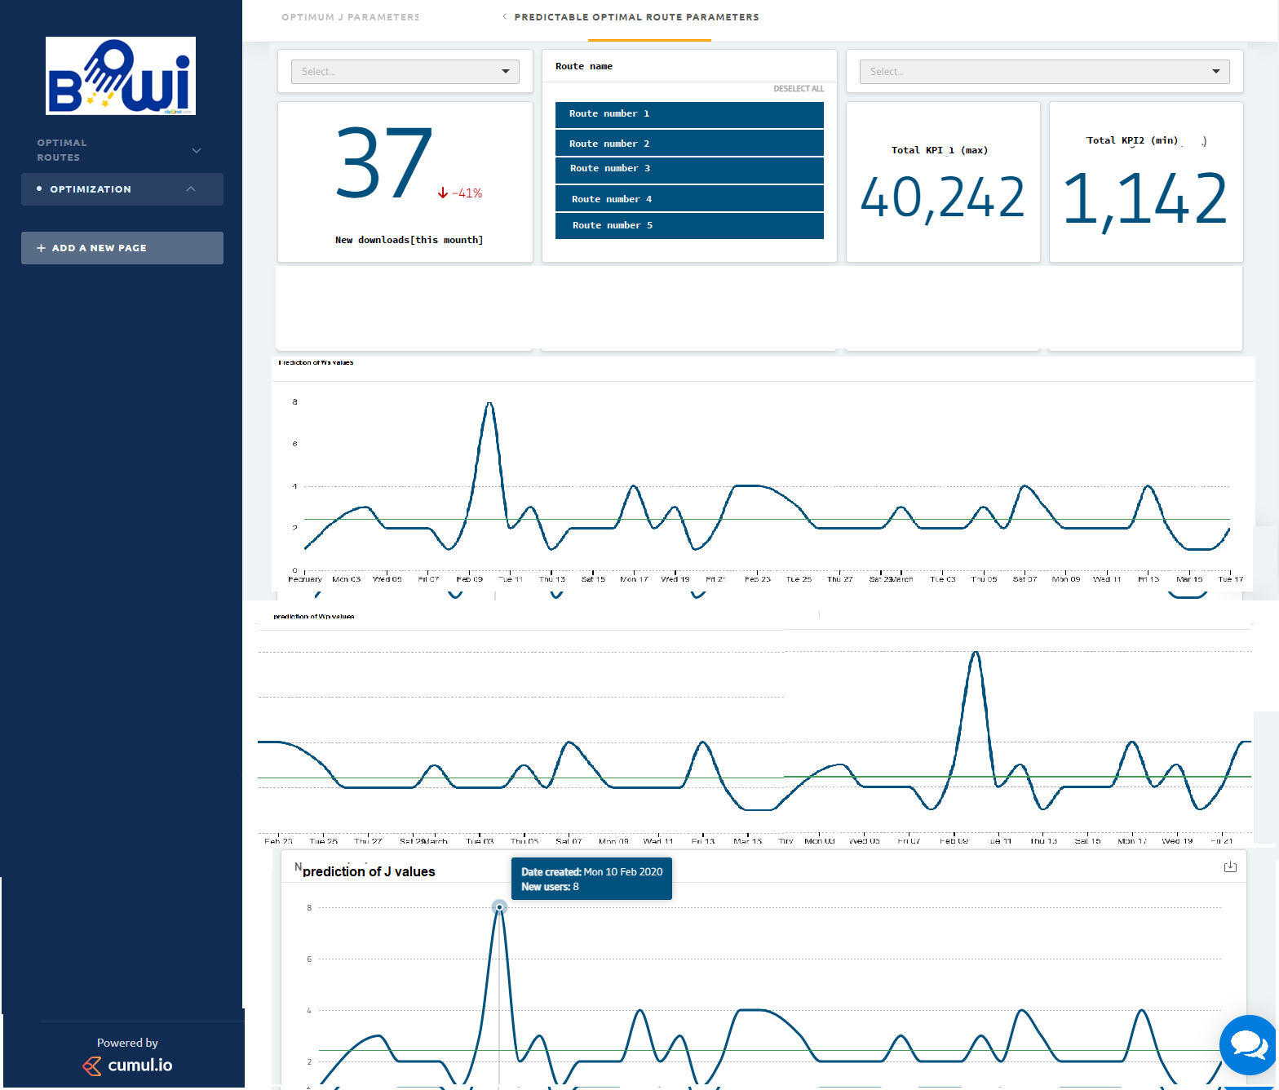
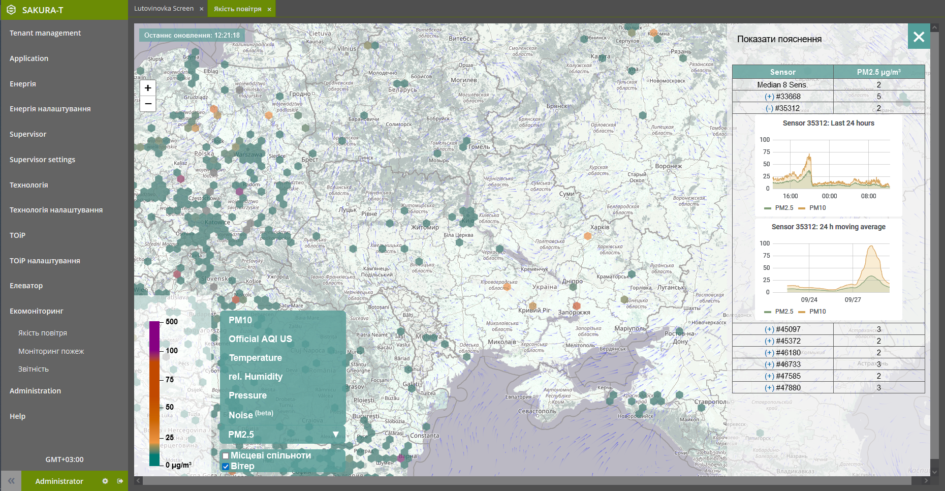
KPI 1. Increasing the number of system functions
Target value of KPI: Increasing the number of SAKURA-APM system functions from 4 to 7
Reached value of KPI: 7
The dashboard allows you to display –
The optimal action diagram (parameter J). Using scrolling, you can select the required number of nodes on the route. On the graph you can view the information on the relevant node.
function 1:
Energy monitoring
function 2:
Energy efficiency
function 3:
Maintenance and repair
function 4:
Product control
function 5:
AI Routing
function 6:
Prediction of energy consumption
function 7:
Environmental monitoring
The dashboard allows for the selected route and node to plot the predicted values of parameters Ws, Wp, Wq and J as a function of time, information is available for each type of node concerned:
J = ks cos φ + kp Ws (Ws max - Ws)
Visualization of data received from environmental monitoring stations in the form of scalable icons.
Visualization of data obtained from public environmental monitoring networks. Analytical processing of data, formation of reporting forms for the selected period

Slide 24
KPI 2. Reducing the percentage of inefficient use of grain elevator equipment
Target value of KPI: from 17% to 10%
Reached value of KPI: 10%
Period | Active energy Wp, [kWh] | Reactive energy Wq, [kVARh] | Total energy Ws, [kVAh] | Power factor cos φ | Inefficiency %
October 2020 - January 2021 | 54 554,13 | 119 744,93 | 137 975,99 | 0,45 | 30,8
October 2021 - January 2022 | 107 403,55 | 177 044,77 | 218 273,11 | 0,54 | 16,9
October 2022 - January 2023 | 93 260,02 | 146 739,53 | 174 222,06 | 0,59 | 9,2
Due to the fact that the energy consumed by the elevator cannot be an indicator for evaluating energy efficiency, the Power factor (averaged cos φ) was chosen as the main parameter.
A number of practical experiments were conducted on weighing at key points of the elevator the amount of grain products moved during the reference period of time. At the same time, the reference average value of the Power factor at the maximum permissible load and throughput of the equipment was 0.65. We used this value as 100% efficiency.
The Inefficiency value of 16.9% was achieved as a result of the application of IoT technologies thanks to the administrative influence and optimization of SCADA, the value of 9.2 thanks to the application of AI technologies.
Generalized statistical data file: D4.1.1_Operation statistics.xlsx
Notes:
Зниження відсотка неефективного використання елеваторного обладнання
У зв'язку з тим, що спожита елеватором енергія не може бути показником для оцінки енергоефективності в якості основного параметра був обраний Power factor (усереднений cos φ).
Було проведено ряд практичних експериментів зі зважування в ключових точках елеватора кількості переміщених зернопродуктів за еталонний проміжок часу. При цьому еталонне усереднене значення Power factor при максимально допустимому навантаженні та пропускній спроможності обладнання склало 0,65. Дане значення ми застосували як 100% ефективності.
Значення Inefficiency в 16,9% вдалося досягти в результаті застосування технологій ІоТ завдяки адміністративному впливу та оптимізації СКАДА, значення 9,2 завдяки застосування технологій ШІ.

Slide 25
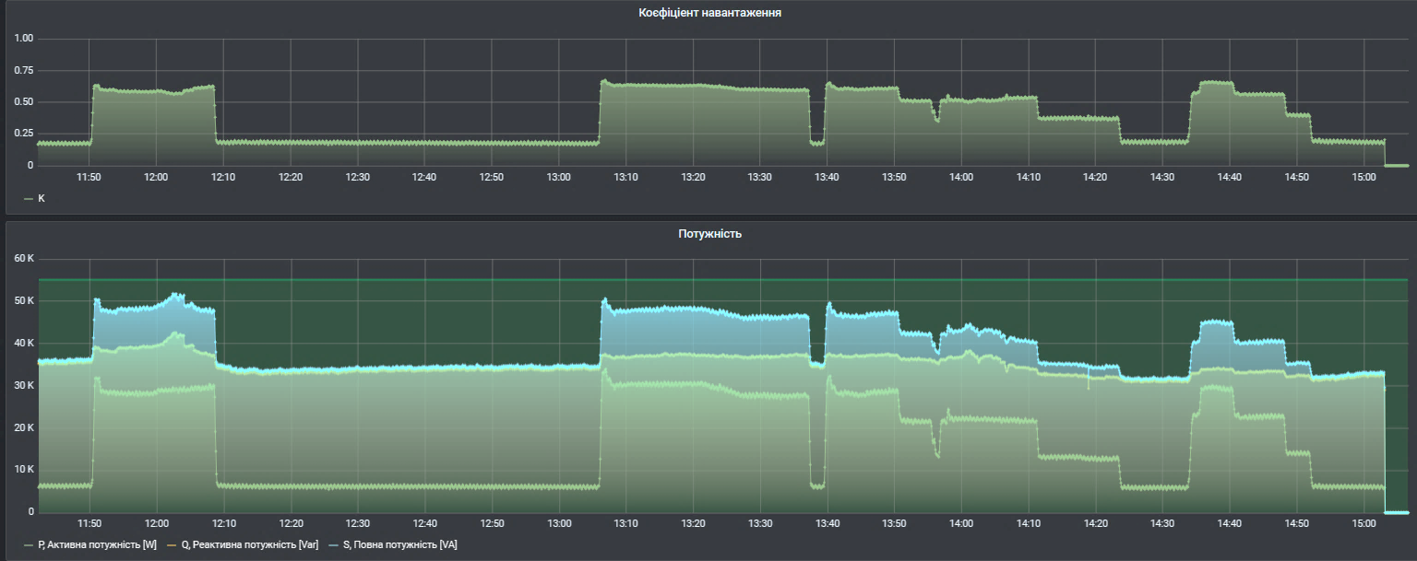
KPI 3. Reducing of energy consumption of technological equipment of grain elevator
Target value of KPI: from 17% to 10%
Reached value of KPI: 15 … 5%
TTE showed that during the design and construction of the elevator, the designers made a mistake by choosing motors of excessive power for the equipment. During TTE, we did not manage to achieve significant results through the use of information and operational technologies, a maximum of 1...2%. The reactive power component remained practically constant, as it significantly exceeds the active energy component.
Full power
Reactive
Reactive
Active
Active
However, we managed to find a way to solve the problem - this is the installation of vector frequency converters. Another effective, but expensive way is to replace the engines with more modern engines of lower power.
We installed vector frequency converters and performed a number of experiments that showed that at any load of the test unit of equipment (transporter No. 36) the Power factor was within 0.95...0.98. That is, it was possible to reduce energy consumption to 2...5%.
Generalized statistical data file: D4.1.1_Operation statistics.xlsx
Notes:
Зниження енергоспоживання технологічного обладнання елеватора
ТТЕ показали, що при проектуванні і побудові елеватора проектанти здійснили помилку, обравши для обладнання двигуни надмірної потужності. В ході ТТЕ нам не вдалося досягти значних результатів шляхом застосування інформаційних і операційних технологій, максимум 1…2%. Реактивна складова потужності лишалася практично сталою так як вона значно перевищує активну складову енергії.
Проте нам вдалося знайти спосіб вирішення проблеми – це встановлення векторних перетворювачів частоти. Іншим дієвим, але дороговартісним способом є заміна двигунів на більш сучасні двигуни меншої потужності.
Ми встановили векторних перетворювачів частоти і виконали ряд експериментів, які показали, що при будь-якому завантаженні тестової одиниці обладнання (транспортер №36) Power factor знаходився в межах 0,95…0,98. Тобто вдалося знизити energy consumption до 2…5%.

Slide 26
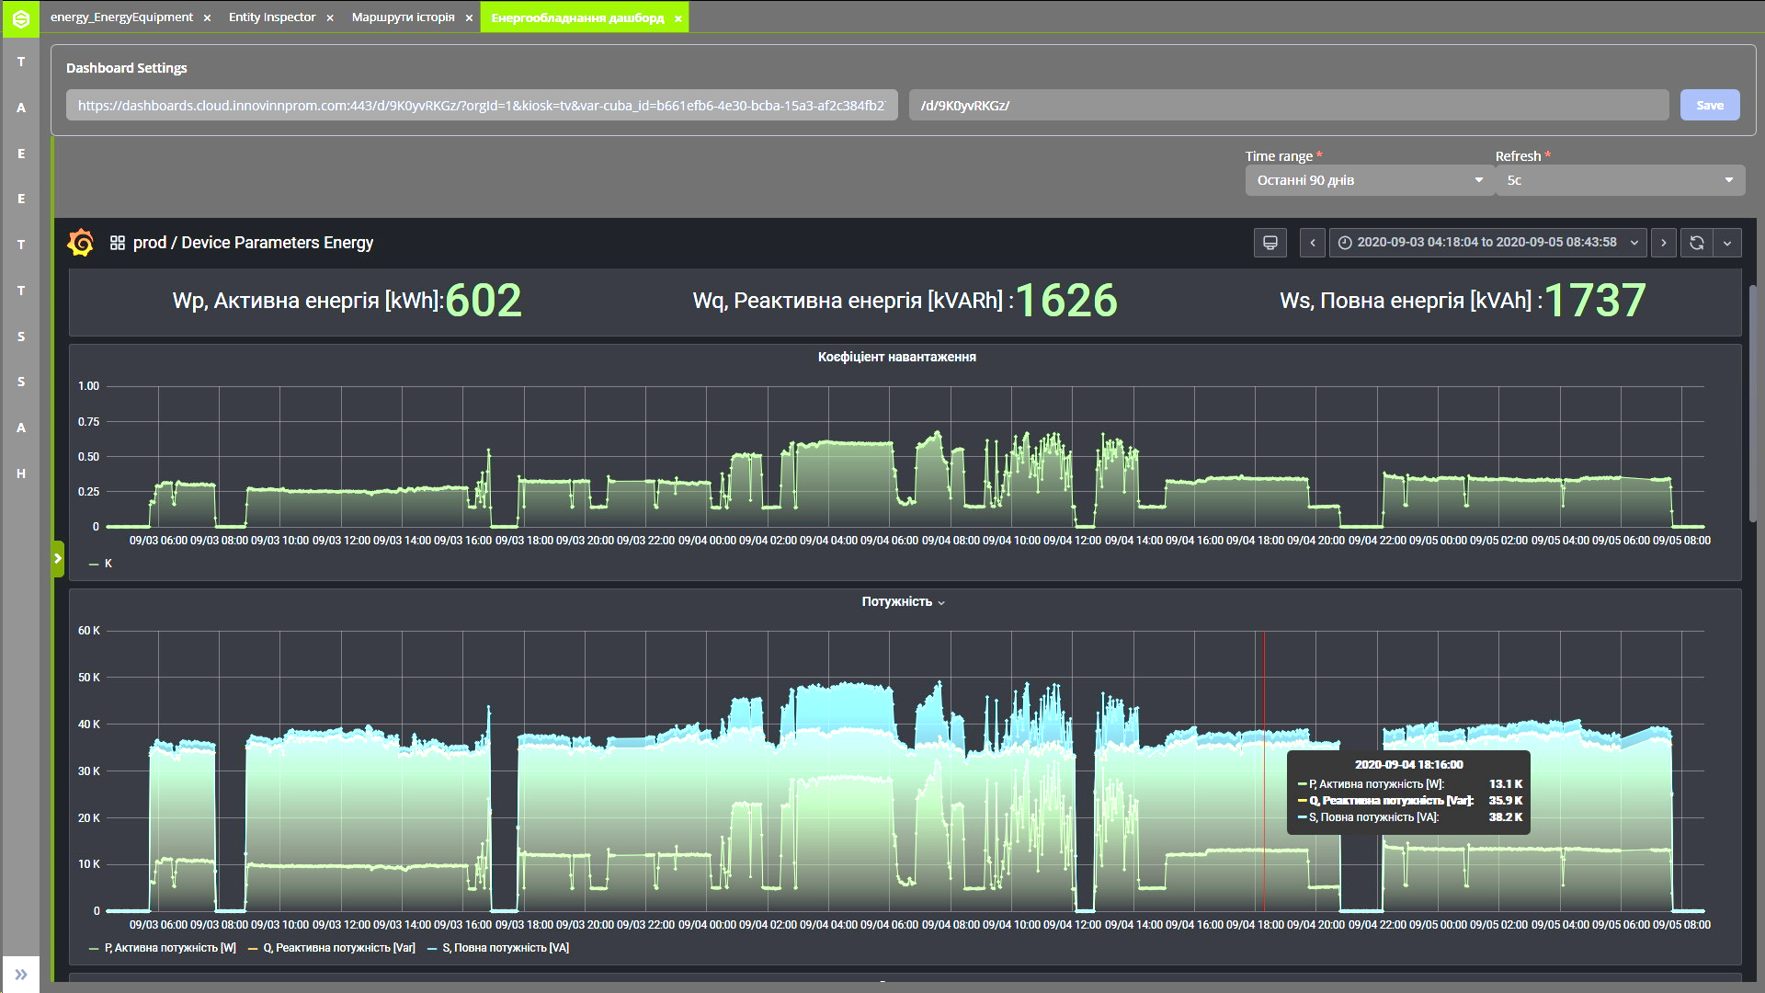
KPI 4. Reducing of technological delays and downtime of grain elevator equipment
Target value of KPI: from 5% to 3%
Reached value of KPI: 3%
The planned KPI level was achieved in the following ways:
According to the results of the analysis of the operation of the equipment (time of acceleration of the engines, time of supplying the product to the next unit of equipment, etc.), we at SKADA reduced the time of switching on and off the routes.
Real-time monitoring of the load (product availability on transport equipment) made it possible to automatically detect cases of equipment operating in idle mode and equipment problems that could cause an unplanned stop on the route.
The load is normal
Partial load, inefficient work
Equipment operation in idle mode
Notes:
Зменшення технологічних затримок і простоїв елеваторного обладнання
Запланованого рівня КПІ вдалося досягти наступними шляхами:
За результатами аналізу роботи обладнання (часу розгону двигунів, часу подачі продукту на наступну одиницю обладнання та інш.) ми в СКАДА скоротили час ввімкнення і вимкнення маршрутів.
Реал-тайм контроль навантаження (наявності продукту на транспортному обладнанні) дозволив автоматично виявляти випадки роботи обладнання в холостому режимі та проблеми з обладнанням, які можуть спричинити незаплановану зупинку маршруту.
Навантаження в нормі
Часткове навантаження, неефективна робота
Робота обладнання в холостому режимі

Slide 27
KPI 5. Negotiations with potential customers
Target value of KPI: Negotiations regarding the introduction of SAKURA-APM
with two potential clients
Reached value of KPI: five potential clients
Negotiations are underway regarding the implementation of SAKURA-APM at 5 enterprises of the PrJSC "Myronivsky Plant for the Production of Cereals and Compound Feeds", an Implementation Plan has been developed, a number of contracts have been concluded, during which INNOVINNPROM performs work on the preliminary modernization of SCADA systems.
Negotiations are underway regarding the implementation of SAKURA-APM at the 7 grain elevators of the ASTARTA-Kyiv agricultural holding, commercial proposals have been submitted, and a test version of the system has been deployed at one of the enterprises.
Negotiations are underway regarding the implementation of SAKURA-APM at the 2 grain elevators of the UkrLandFarming agricultural holding, commercial offers were provided.
Negotiations are underway regarding the implementation of SAKURA-APM at the 7 grain elevators of the ZahidBug agricultural company, commercial offers were provided.
Negotiations are underway regarding the implementation of SAKURA-APM at the 3 grain elevators of the Agroprosperis Group agricultural company, commercial offers were provided.

Slide 28
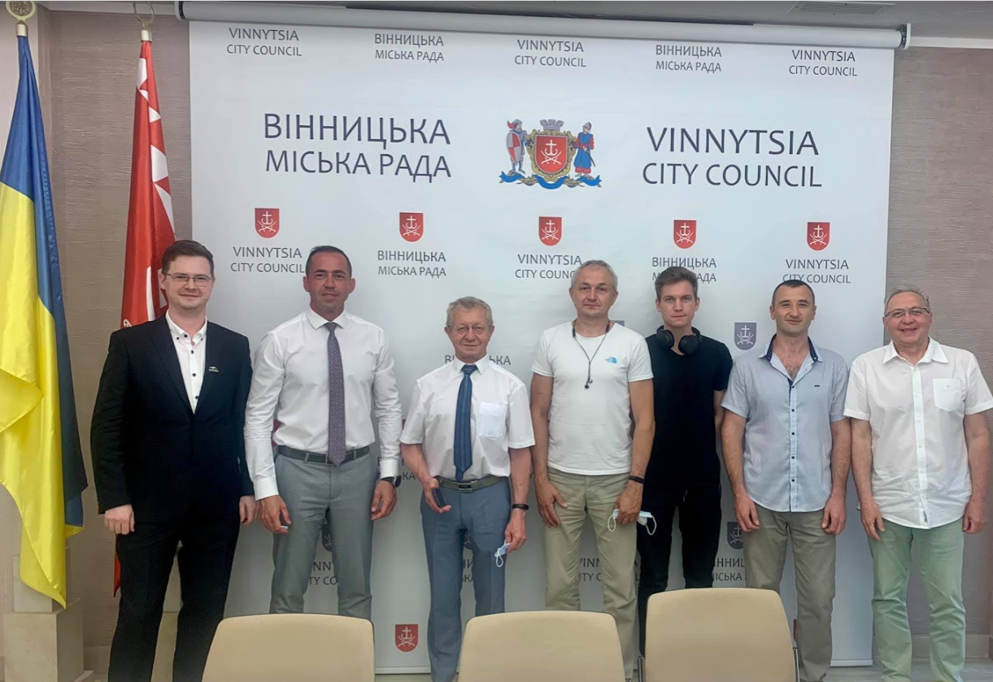
KPI 6. Participation in public events (conferences, forums, fairs, exhibitions, etc.)
Target value of KPI: Participation in two events
Reached value of KPI: >10
Monthly public meetings with heads of enterprises within the Vinnytsia Automation and Instrument Making Cluster
Speech with a presentation of SAKURA-APM for enterprise managers at the site of MHP agricultural holding
Participation in the Scientific & Technical Conference at the Vinnytsia National Technical University System Analysis and Information Technologies Department. Topic: Development of information technologies to optimize grain elevator operation using neural network models and reinforcement learning methods.
Presentation of the company's capabilities, including PaaS SAKURA-IIOT in Vinnytsia City Hall

Slide 29
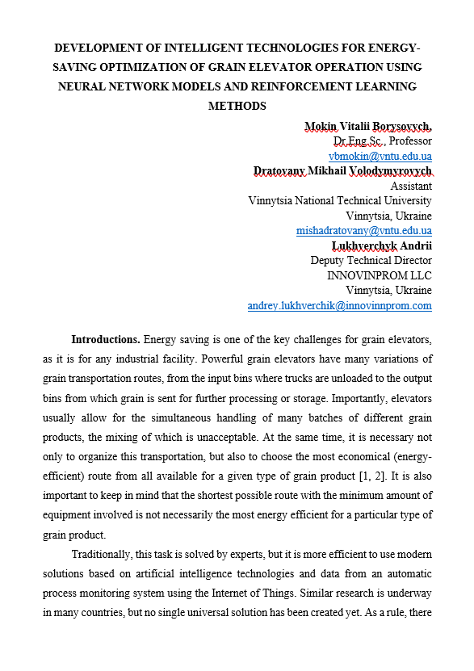
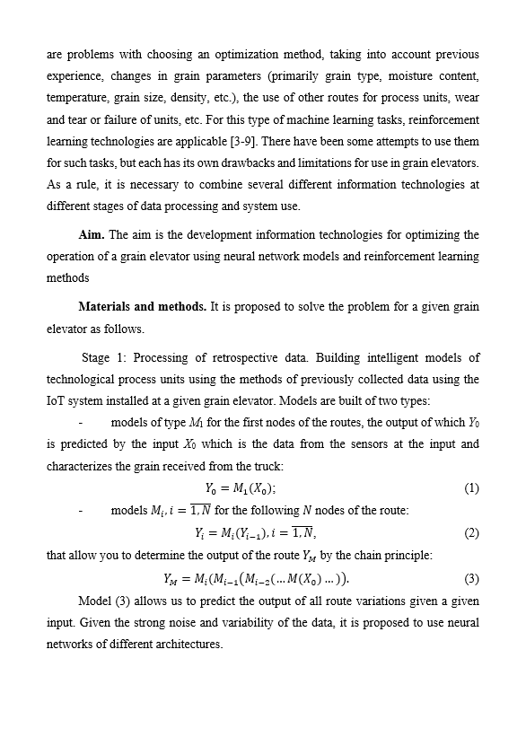
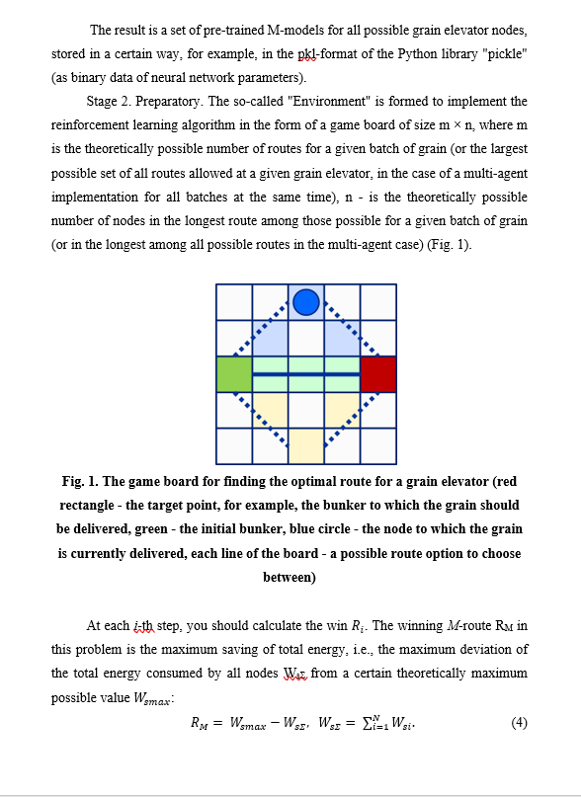
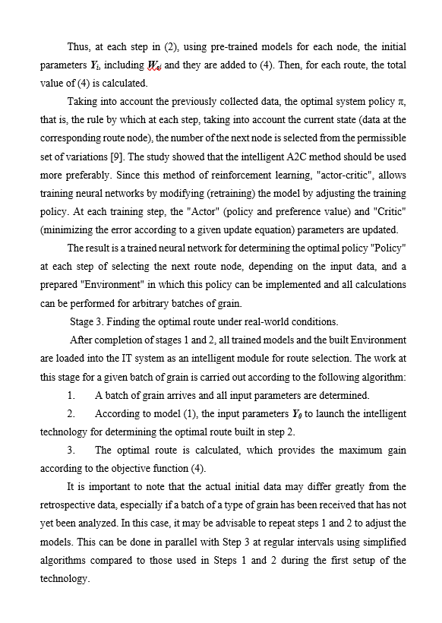
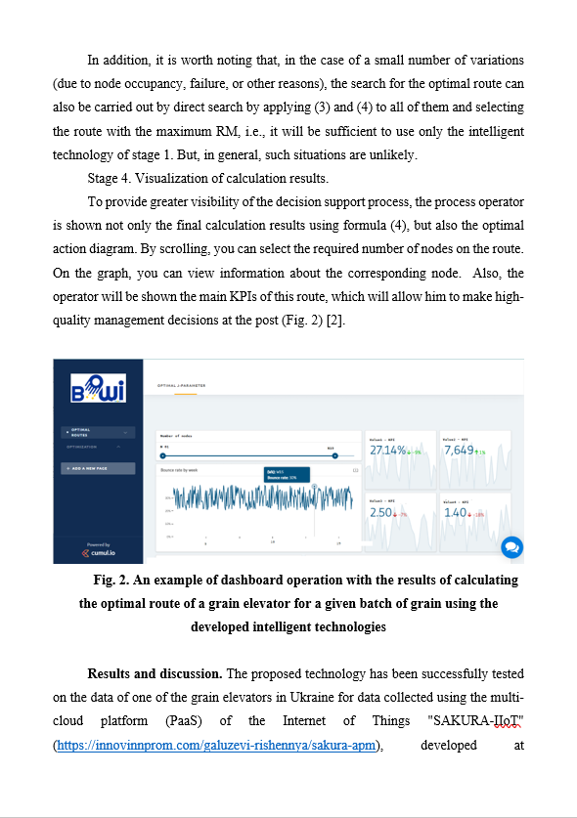
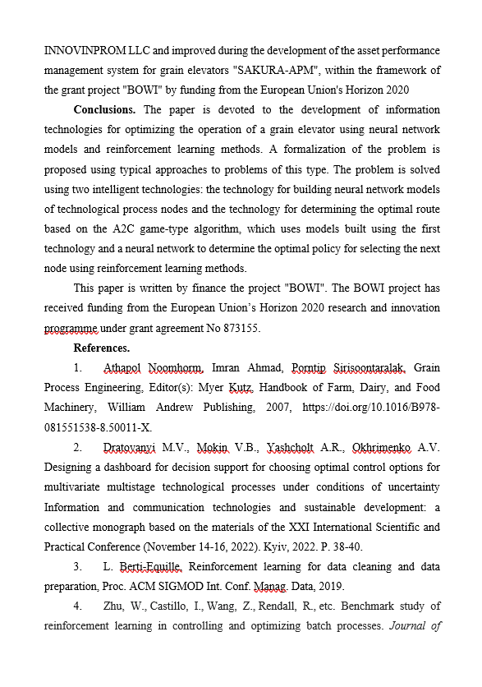
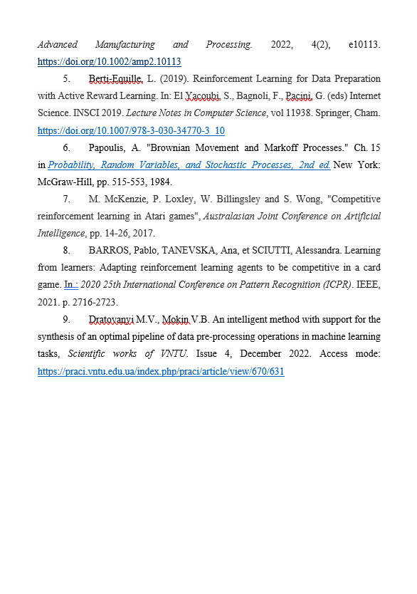
KPI 7. Publications in media and social networks
Target value of KPI: Creation of three publications
Reached value of KPI: 3
Publication on the Company website: https://innovinnprom.com/galuzevi-rishennya/sakura-apm
Publication in the LinkedIn network: https://www.linkedin.com/feed/update/urn:li:activity:6915988724539346944/
Publication jointly with Vinnytsia National Technical University D5.2_Theses_Munich_BOWI.docx V International Scientific and Practical Conference Scientific Progress: Innovations, Achievements and Prospects, No 29

Slide 30
Support from BOWI project
Many mentoring meetings from Centre 4.0 KPI DIH have been held – 9 meetings on a regular basis according to the schedule agreed in the TAR – second and fourth Tuesday of each month. Also, it should be noted support from PIAP DIH which included Technical and business consulting, TAR improvements, etc. According to the results of the meetings, SMEs received the following support from BOWI and benefit from that:
Assistance in setting up technical processes;
Technical and business consulting;
Monitoring the implementation of the project plan;
Coordination of assistance to customers and project executors;
Coordination and assistance in the preparation of the report and presentations on the project;
Organizing communications with other project participants;
Consultations on the formation and improvement of KPI.

Slide 31
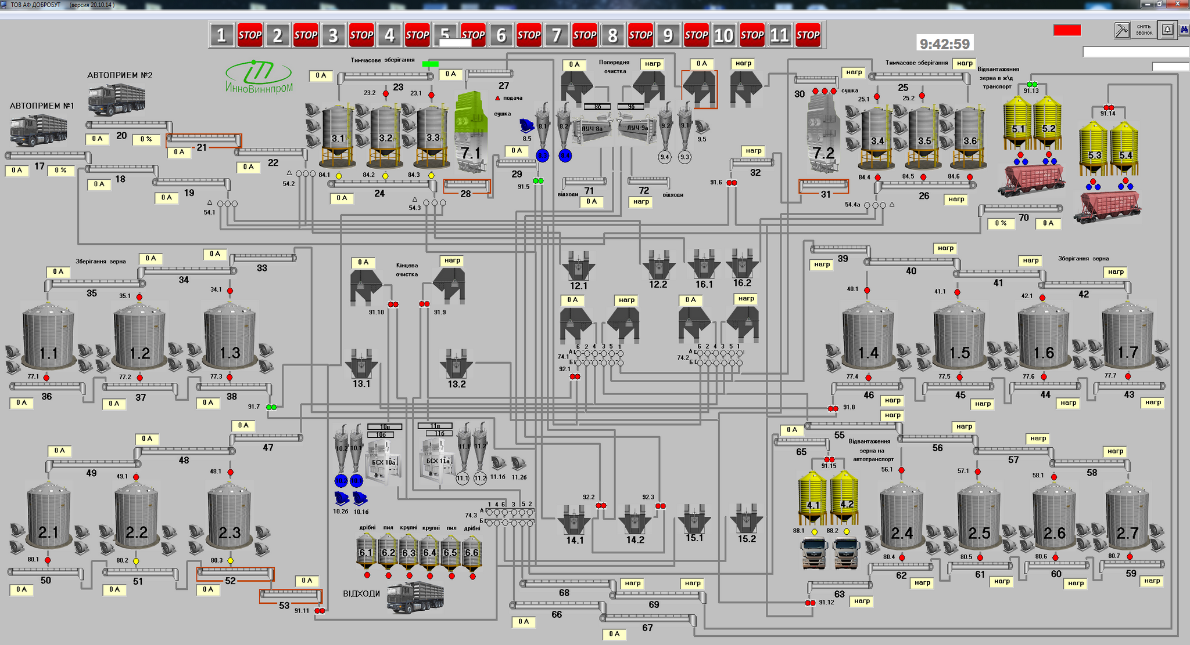
Support from DIH PIAP
During TTE, we faced the problem of choosing and training AI and ML models for different grain crops. After carrying out an expert assessment of the problem, DIH PIAP offered us to install additional IoT sensors in the most important places of the technological process, namely intelligent video cameras to recognize the types of grain crops that are received or shipped from the grain elevator.
Support from DIH PIAP:
Networking, project management consulting.
Selection of equipment, design of auxiliary elements and embedded software.
Choosing an intelligent camera, designing interfaces, creating a framework for the necessary software.
Preparation of the description of system in the form usable in future applications for funds, e.g. state-of-art with innovation aspects mentioned.
AI & ML module

Slide 32
Links and info
INNOVINNPROM LTD Shevchenka 5a street, Vinnytsia, Ukraine
Link to company web site: https://innovinnprom.com
Link to TTE web site: https://innovinnprom.com/galuzevi-rishennya/sakura-apm
Link to project: https://cloud.innovinnprom.com
Link to ECO web site: https://www.eco.sakura.ms/?lang=en
Detailed version of presentation https://docs.google.com/presentation/d/1Dk07izCzSphVNH4HDoegGIxWfJVM3ctB/edit

Slide 33
SAKURA-APM
This project was funded from BOWI Horizon 2020 project

