Slide 1



INNOVINNPROM
  Industrial Automation
  Sustainability
  Energy Efficiency
  Monitoring and Analytics
  Flexible Robotic Systems
Created By : INNOVINNPROM
https://innovinnprom.com/

Slide 2













Sustainability
INNOVINNPROM is an accredited supplier of sustainable development technologies to a number of EU and US consortia.
We specialize in the implementation of technologies that optimize the use of natural resources, reduce the environmental impact of production processes and facilitate the transition to a circular economy.
Energy efficiency - implementation of energy-saving systems and smart grids.
Environmental management is the development of technologies that reduce environmental pollution and carbon emissions.
Innovations - implementation of sustainable development projects based on new technologies.
We are committed to balancing economic development, social well-being and environmental protection, making the world a better place for ours and future generations.
Society
Tolerable
Fair
Sustainable
Environment
Economy
Viable

Slide 3



Digital Transformation with INNOVINNPROM
Twin Transition
Digitalization
Get the full spectrum of data
Digital Transition
Greening
OF & BY
Sustainability Transition
IT & Data
Energy efficiency
Optimizing the energy efficiency of processes
the
Sweet Shot
where Digital amplifiers Sustainability
Full automation
Minimizing the impact of the human factor
Environmental monitoring
Reducing the negative impact on the environment
Robotization
Development and manufacture of robotics
https://innovinnprom.com/

Slide 4




International Projects
Project in the field of energy efficiency of production
Control and optimization of energy costs
funding from the EU's Horizon 2020 research and innovation programme
Under grant agreement No. 873155
Grain storage quality control project
Development of grain quality control technologies
funding from the EU's Horizon 2020 research and innovation programme
under grant agreement No. 101104445
Sustainable development services project
Optimizing the processes of two Ukrainian companies
funding from the EU's Horizon 2020 research and innovation programme
under grant agreement No. 101058613
funding from the EU's Horizon 2020 research and innovation programme
under grant agreement No. 101074549
Sustainable development services project
Advising businesses
Energy Security Project of Ukraine
Optimization of UKRENERGO's information processes
Funded by Tetra Tech ES, Inc. under a USAID contract
№ 72012118C00003
In addition, INNOVINNPROM cooperates with a number of international companies and digital innovation hubs to scale up sustainability solutions and innovative technologies in Ukraine

Slide 5

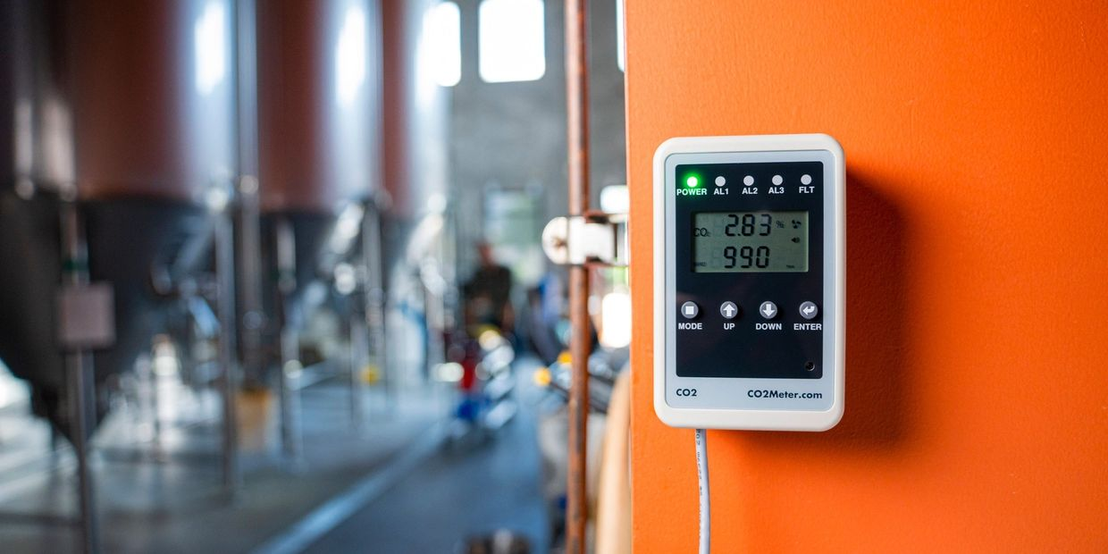
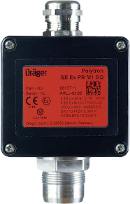
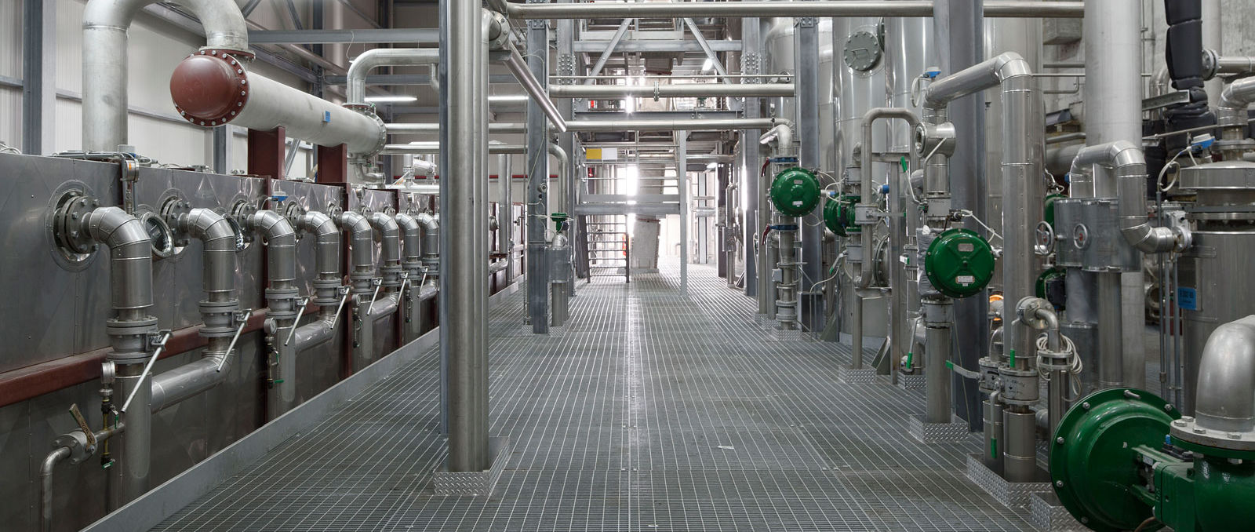
Environmental Monitoring
INNOVINNPROM is a provider of environmental monitoring and control of gas emissions by industrial enterprises.
INNOVINNPROM is the developer of the State Monitoring Programme in the field of atmospheric air protection for 2022-2026 for the Vinnytsia zone.
IoT шлюз
АСУ ТП
Our solutions in the field of emissions control and working conditions are one of the pillars of ensuring sustainable production and reducing the negative impact of enterprises on the environment

Slide 6
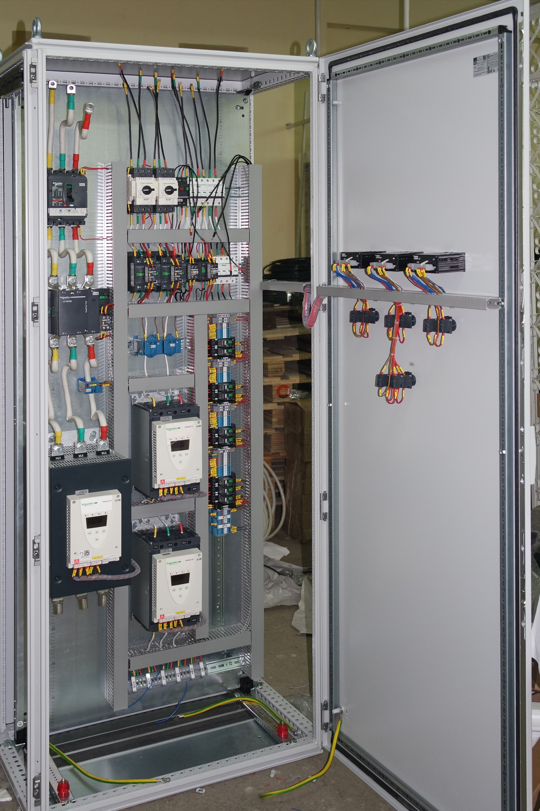
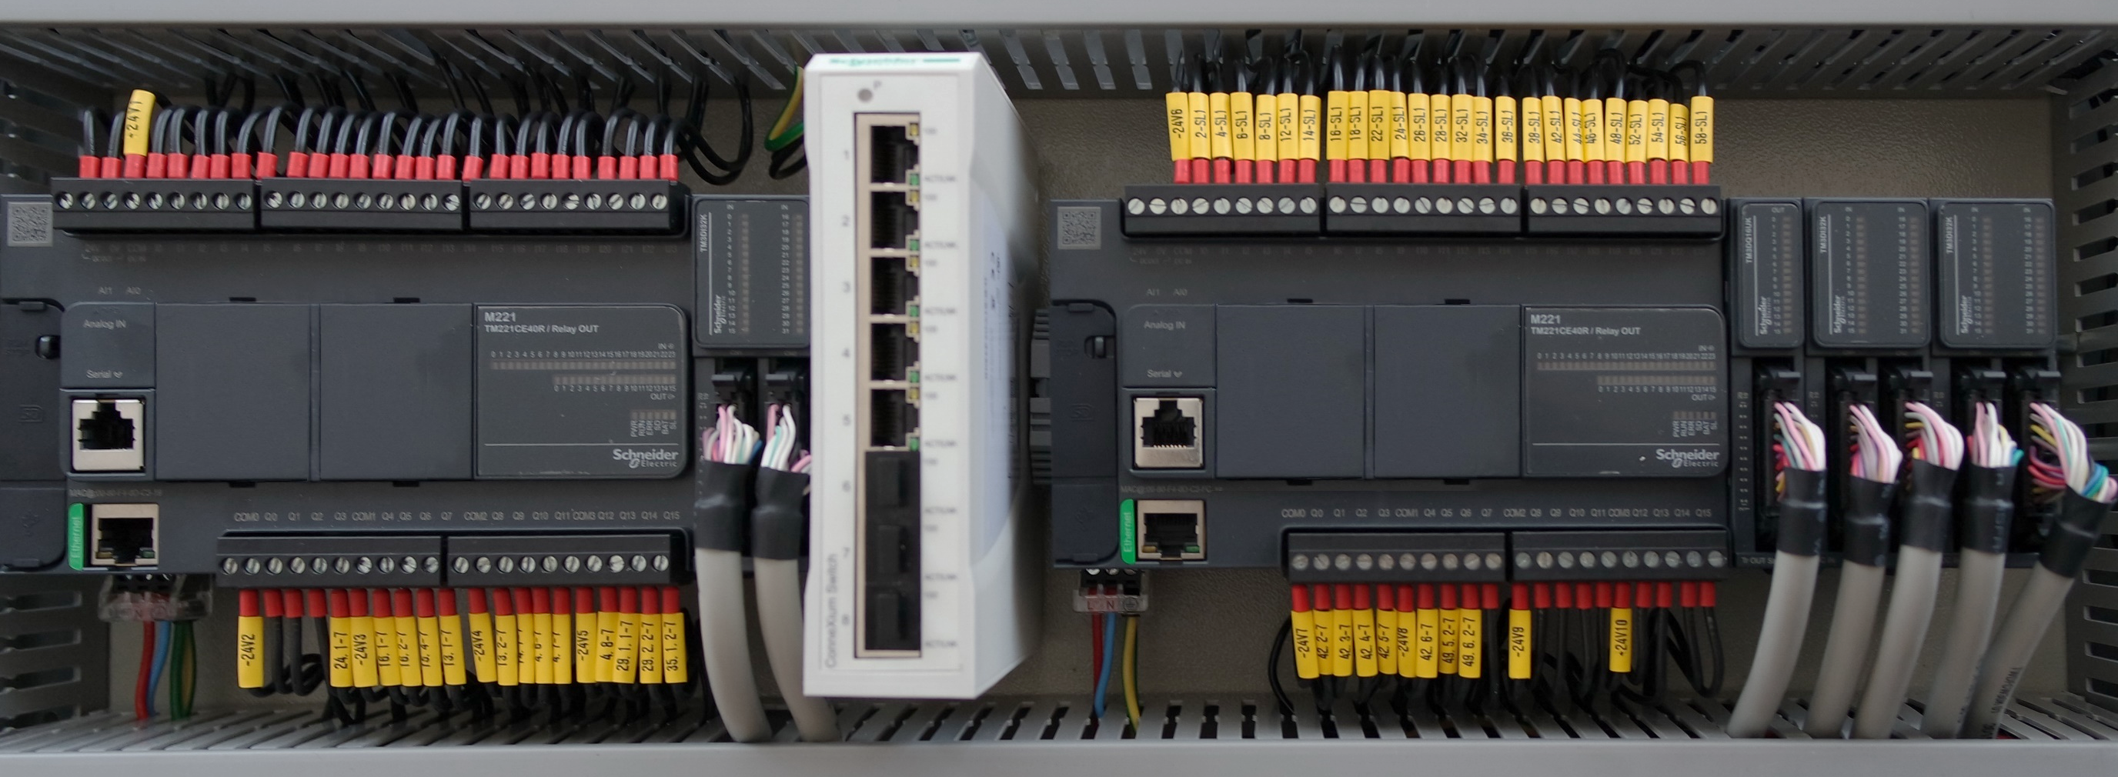
Energy Monitoring
When designing and implementing projects, we strive to achieve maximum control over energy consumption. In doing so, we take into account not only total energy but also its active and reactive components. This enables us to analyze the technology more accurately and to influence the course of technological processes more precisely and subtly.
In addition to electricity, our projects monitor and regulate the consumption of all energy resources - gas, heat, water, pellets, etc. - and control generation

Slide 7
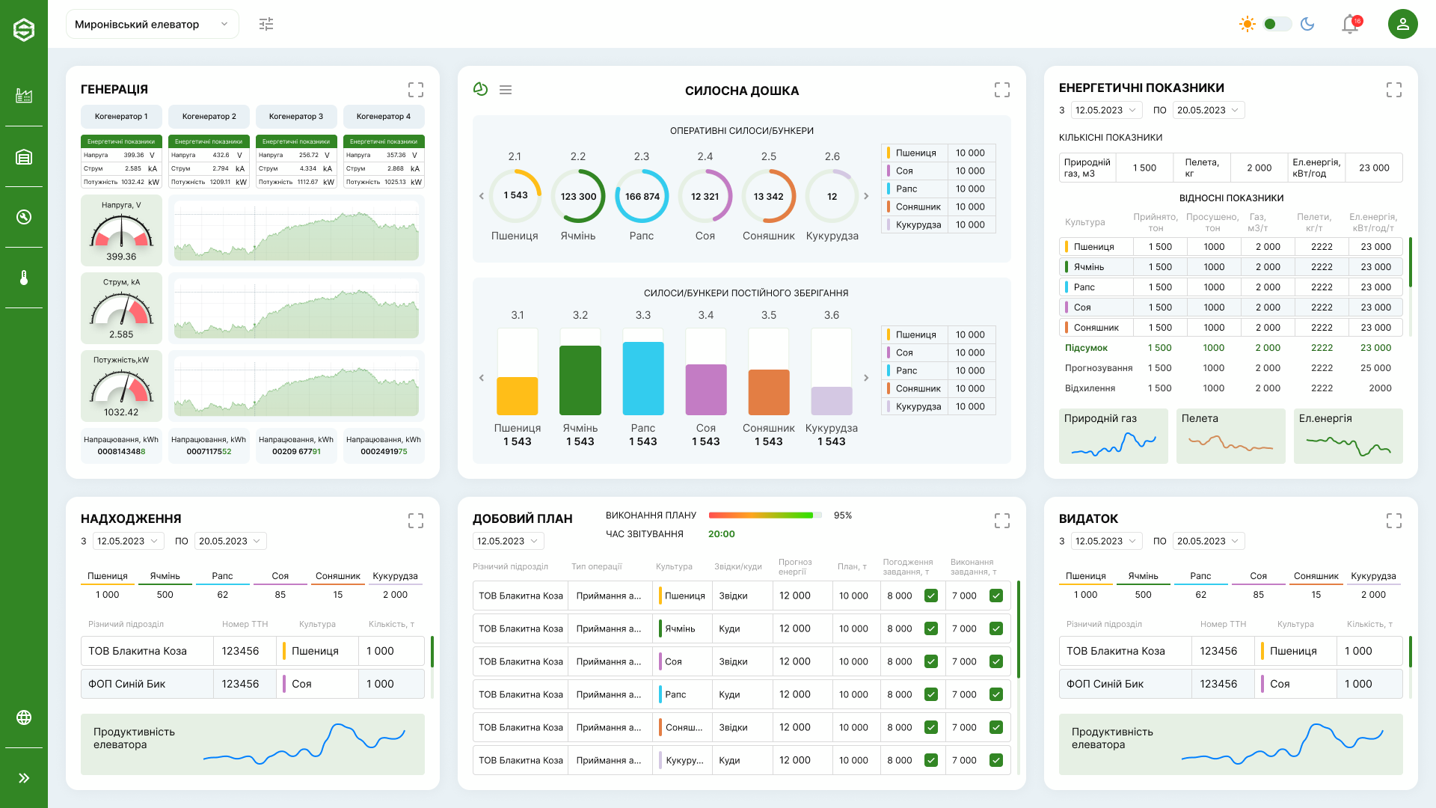
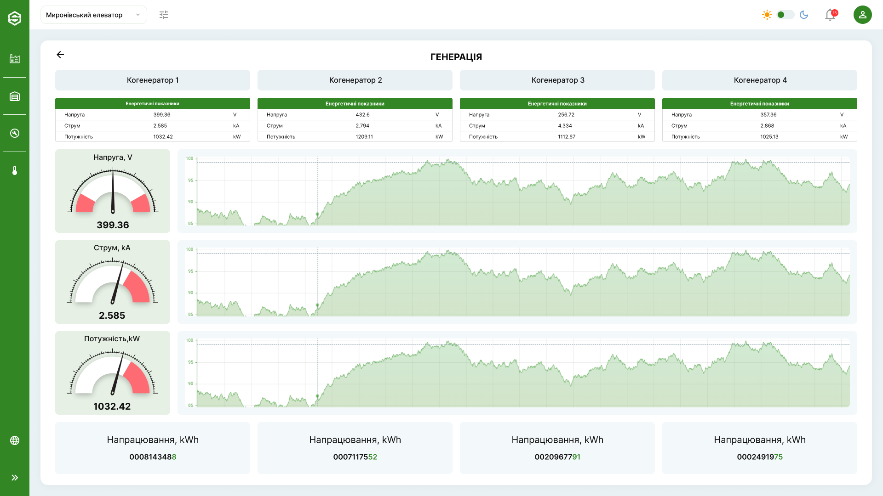
Energy Efficiency
INNOVINNPROM implements a range of solutions for analyzing and optimizing energy consumption and the efficiency of production processes. We use IoT, Cloud Computing, Big Data, AI & ML technologies to implement real-time optimization projects for large enterprises.
As an example, the screens of a system for monitoring and optimizing energy consumption and productivity of a grain elevator are shown. The productivity of production processes is analyzed

Slide 8
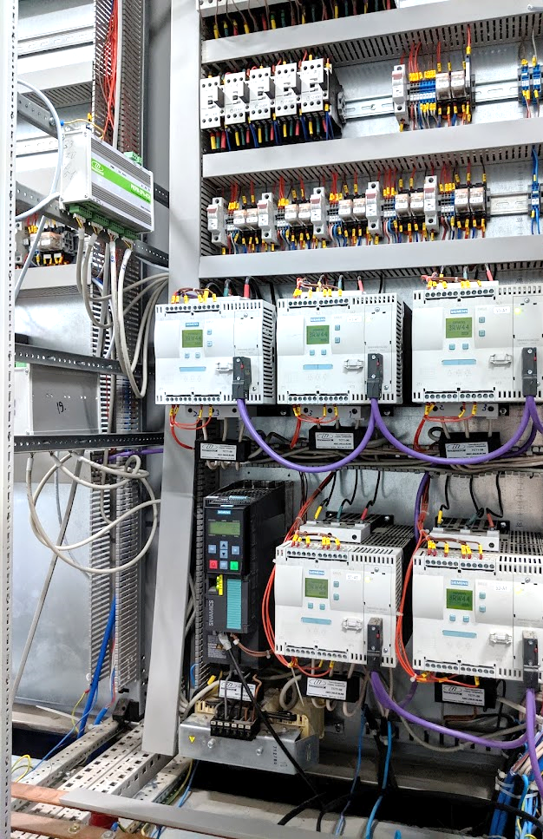
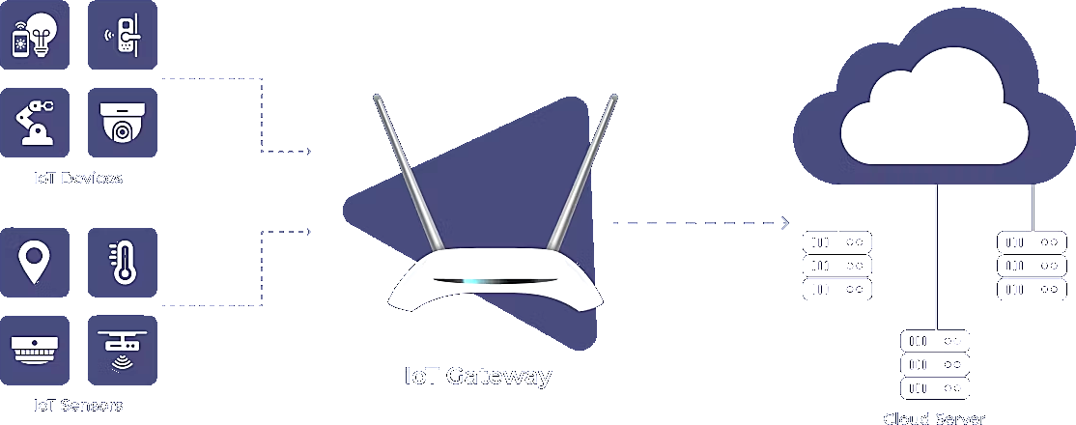
Industrial IoT Technologies
We have experience in installing IoT equipment (Internet of Things equipment) in existing facilities in existing cabinets.
In order not to interfere with existing data collection and transmission systems, we use IoT gateways - devices that transmit data directly to cloud databases, which transfer and synchronize data.
САКУРА-ІІоТ
INNOVINNPROM processes all industrial interfaces and data transfer protocols

Slide 9

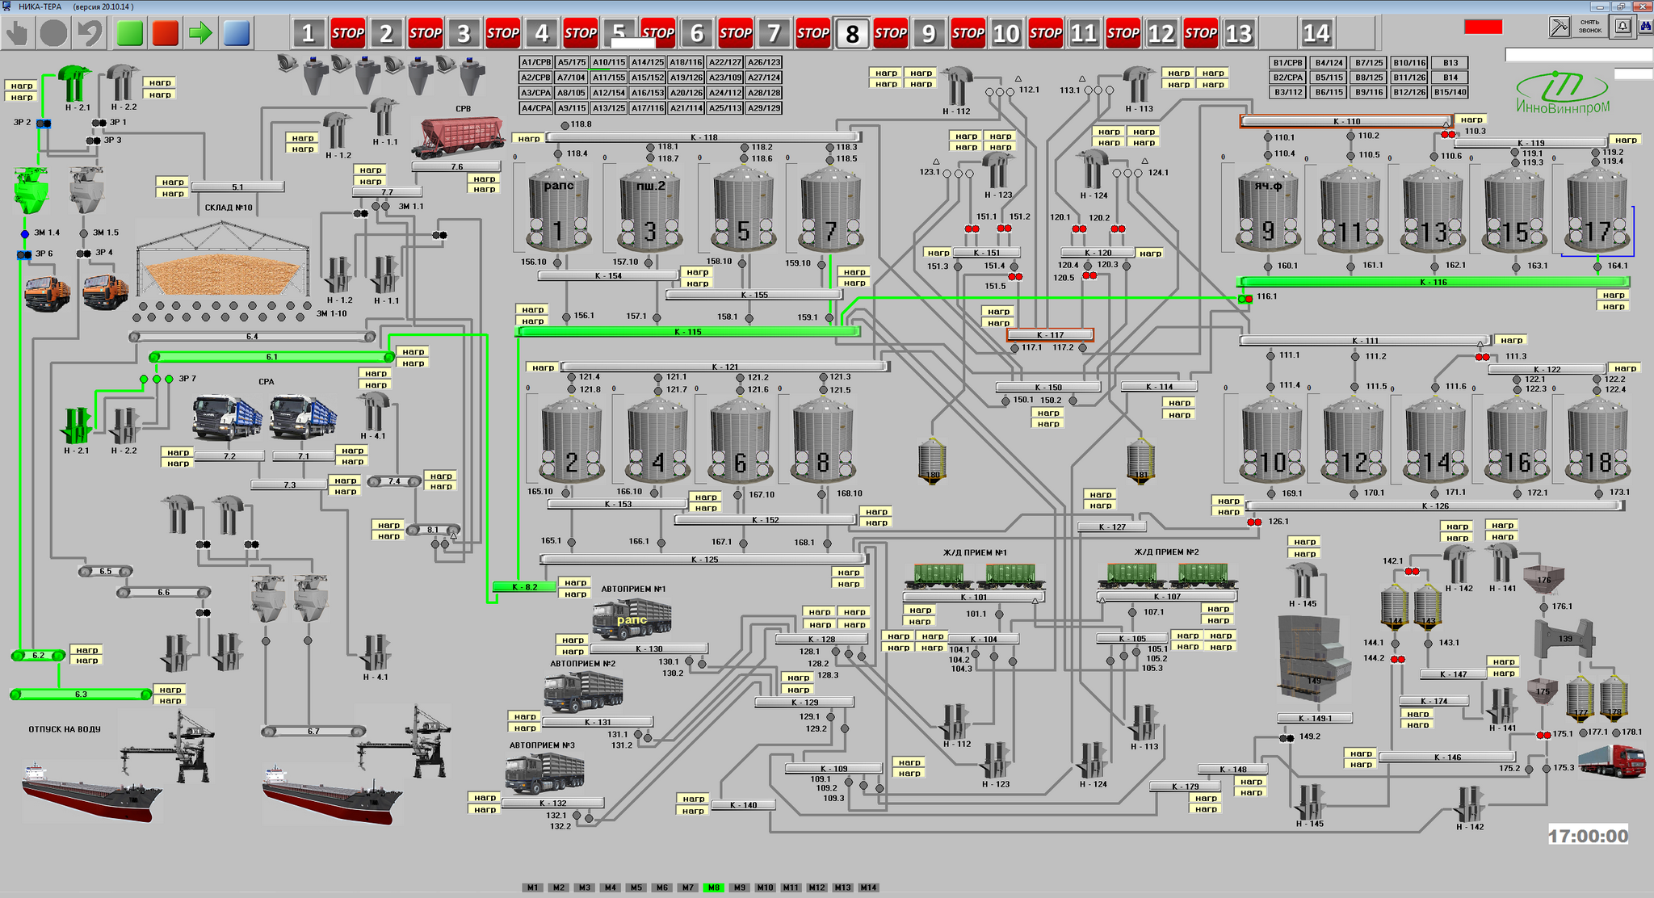
Automation
INNOVINNPROM implements a full range of automation solutions for enterprises of any level.
The company's portfolio includes hundreds of successfully implemented projects, including the largest grain elevators and mills in the EU, as well as sea grain port terminals.
We provide the highest level of automation when a giant enterprise is run by one person without a university degree.
As an example, the main screen of a seaport grain terminal control system with tens of thousands of monitoring and control channels is shown. The yellow boxes contain energy monitoring data.

Slide 10
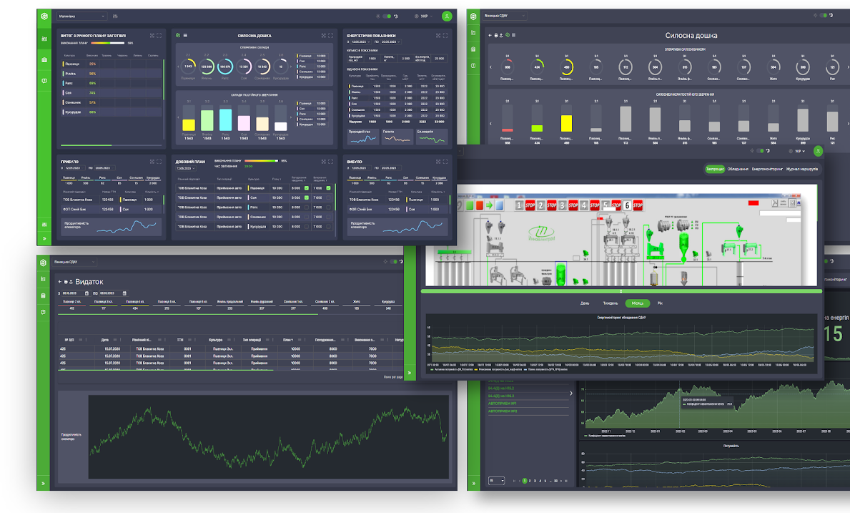
Analytics
INNOVINNPROM covers the entire range of state-of-the-art IT and telecommunications technologies that ensure the digitalization and automation of enterprises (holdings) at all levels.
We find and solve problems that negatively affect the energy efficiency and production efficiency of enterprises and provide tools to overcome them and reduce financial losses.
https://innovinnprom.com/

Slide 11

Own Cloud Platform
To process large amounts of data, INNOVINNPROM has developed and maintains its own cloud-based platform for the industrial Internet of Things, SAKURA-IIoT. The platform allows collecting, accumulating and analyzing large amounts of data coming from industrial facilities every second and providing users with consolidated information anywhere in the world. The platform is based on modern technologies and is deployed on Hetzner's server facilities with the possibility of migration to cloud services of another provider at the customer's request.
SAKURA-IIOT provides the ability to consolidate all enterprise (holding) data in a single place, to perform fast analytical data processing in real time, to summarise data and provide it to the user in a convenient graphical, tabular and textual form, using cloud computing technologies.
https://ivp.vn.ua/agro
https://innovinnprom.com/
Project website and examples of solutions for link

Slide 12
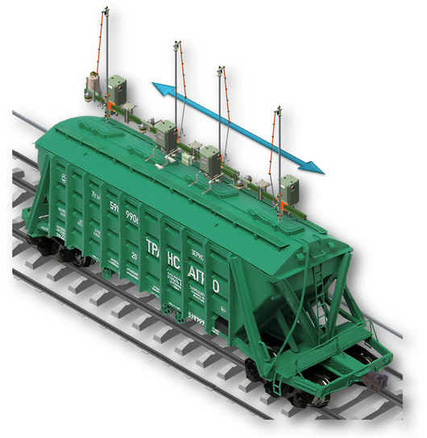
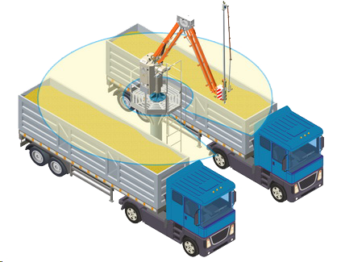
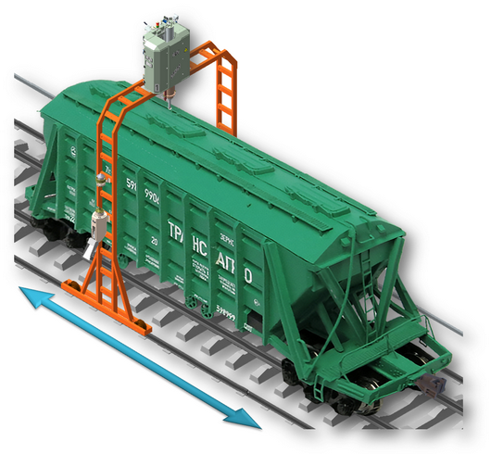
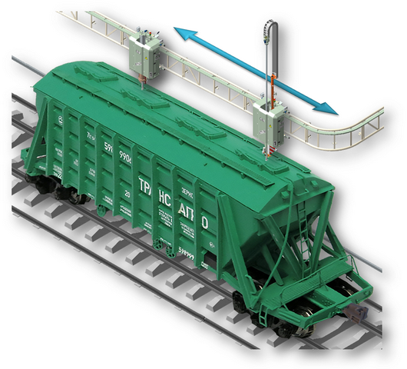
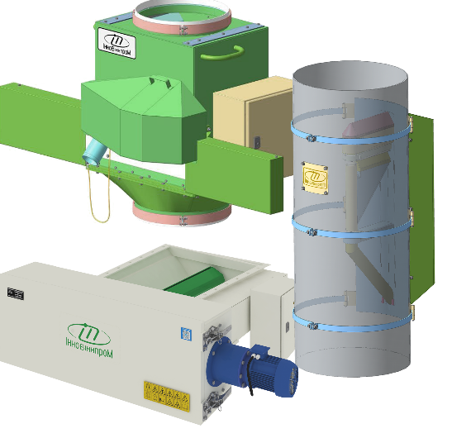
Robotization
INNOVINNPROM develops and mass-produces robotic systems for solving unique production problems. These include such diverse tasks as automatic sampling of grain products and liquids, diagnostics of car chassis, and automatic loading/unloading of pneumatic mail capsules.
Our robotic systems are an example of the combination of mechanical, hydraulic, pneumatic, electrical, microprocessor-based systems and software at all levels to control them.
We have implemented more than 50 projects in Ukraine and are currently implementing projects to optimize grain logistics in the seaports of Lithuania and Romania.
Truck Systems
Railway Systems
Flow Systems
As an example, automatic grain sampling systems are shown from car bodies, hopper wagons, and warehouse flows

Slide 13
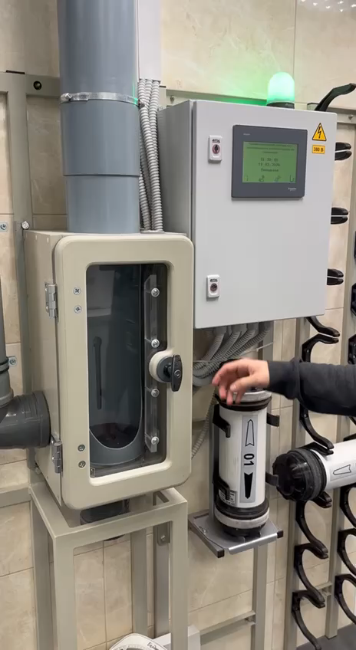
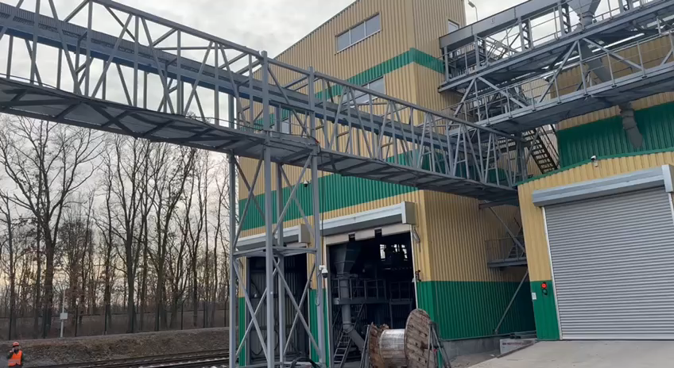
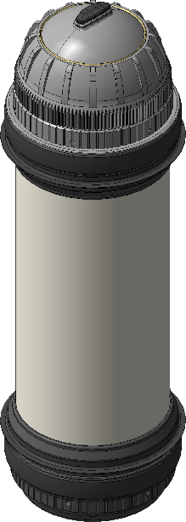
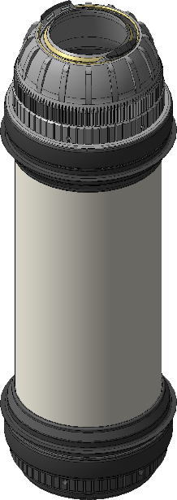

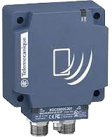
Pneumatic Tube Systems
INNOVINNPROM develops and mass-produces long-distance pneumatic product transfer systems that operate in harsh industrial environments. These pneumatic tube systems are integrated into the logistics and information networks of enterprises. At the same time, the pneumatic capsules are equipped with RFID sensors, which allow monitoring the movement and loading/unloading of the capsules.
A unique feature of INNOVINNPROM pneumatic capsules is the ability to automatically load/unload them. That is, INNOVINNPROM pneumatic tube systems provides the ability to receive and load raw materials directly from product streams.
Automatic capsules
RFID tags for capsules
As an example, we show the implementation of pneumatic mail for the delivery of bulk products over a distance of >350m between the production halls of an enterprise.

Slide 14
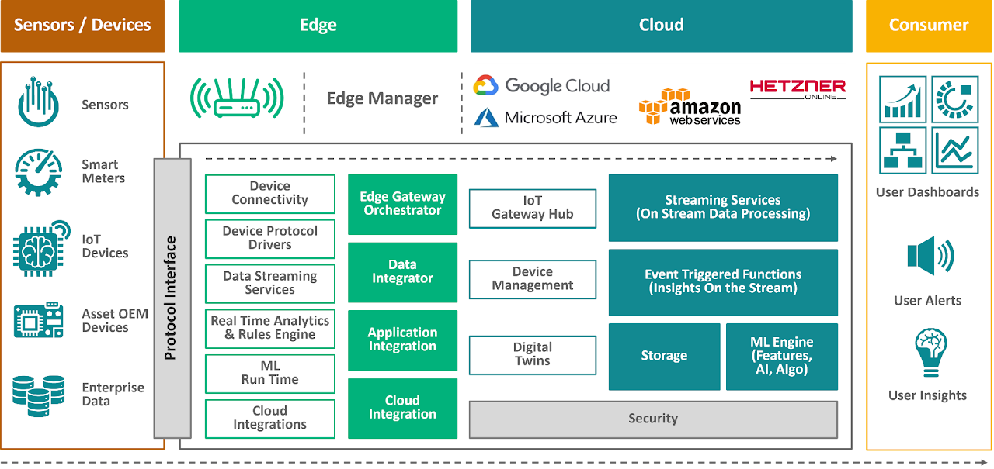







Technology Stack
INNOVINNPROM covers the entire range of modern Industry 4.0 OT and IT technologies that ensure the digitalization and automation of enterprises (holdings) at all levels.
Internet of Things
Artificial Intelligence
Machine Learning
Edge Computing
Big Data
Cyber Security
Digital Twin

Slide 15











Services
Design
Maintenance
Electrical
installation works
Construction
Production of controllers
Warranty
service
Commissioning and adjustment works
Post-warranty
service
https://innovinnprom.com/

Slide 16
Company Structure
INNOVINNPROM has a staff structure that allows it to implement high-tech projects of the highest level of complexity, from sensors to cloud services.
Management
Management of the company and contracts
Marketing department
Marketing and advertising
Project department
Development of project documentation
Contracts department
Maintaining contractual documentation
Operational Technology Department
Development and programming of process control systems
IT department
Software development
Design department
Development of robotics and metal structures
Accounting
Financial accounting and reporting
Implementation department
Implementation and commissioning
Field crews (subcontracting) Equipment installation, cable laying
https://innovinnprom.com/

Slide 17
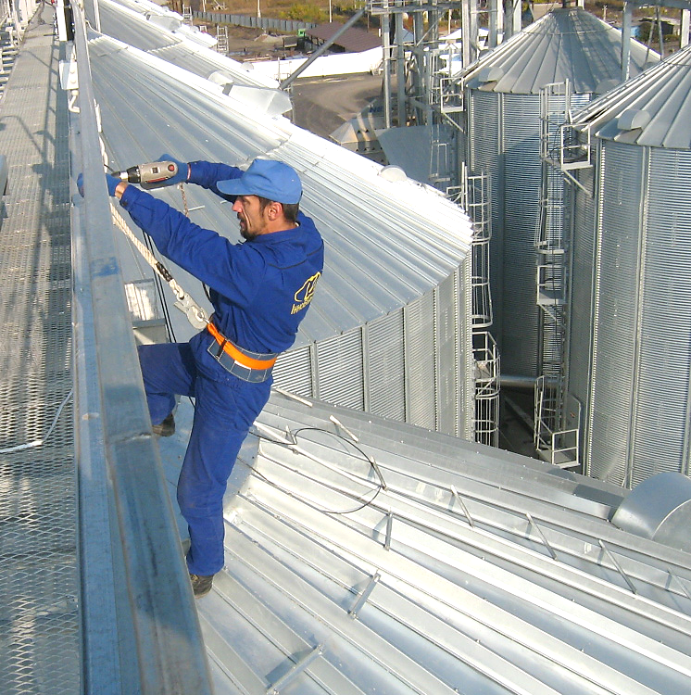
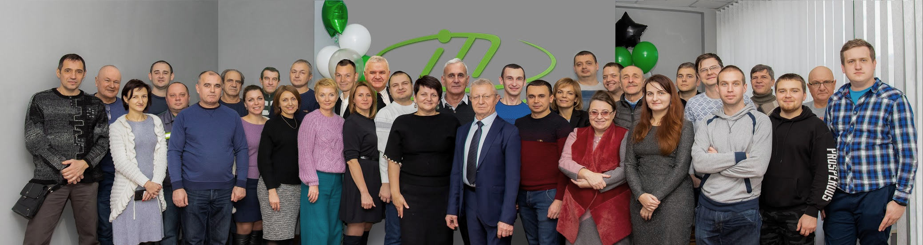
Company Staff
The company employs staff exclusively with higher education.
including:
with a PhD (Doctor of Philosophy) degree in technical and economic sciences
- 3 employees
postgraduate students of higher education institutions
- 2 employees
certified specialists of Schneider Electric, Siemens
- 3 employees
https://innovinnprom.com/
Presented By : INNOVINNPROM

Slide 18




























































































Partner Landscape
Vendors
Suppliers
IT
PATRONI
Designers
Main Clients
Partners
Universities
Clusters

Slide 19
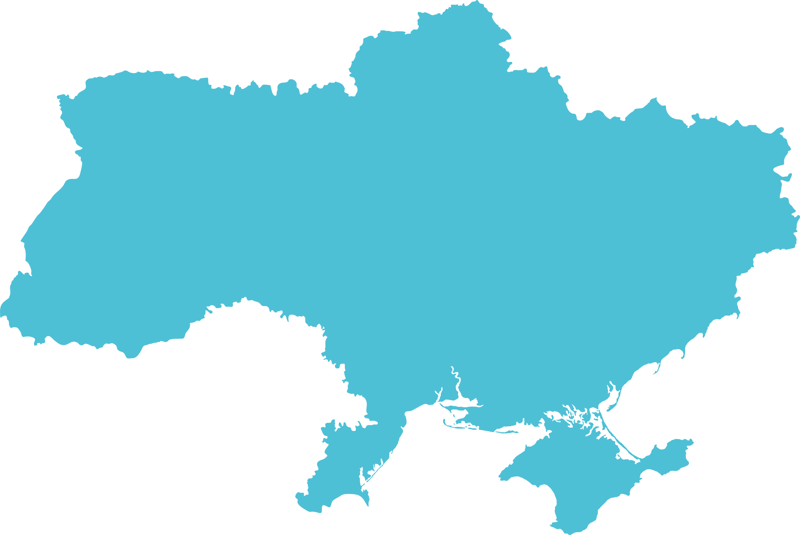







































































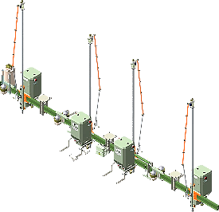







Map of Projects
KAZAKHSTAN
UKRAINE
MOLDOVA
LITHUANIA
SCADA
> 1000 I/O
Truck Samplers
Railway Samplers
SAKURA-B
MES/ERP/PLM
SAKURA-T
Energy efficiency
SAKURA-ECO
Eco monitoring

Slide 20


INNOVINNPROM
  Industrial Automation
  Sustainability
  Energy Efficiency
  Monitoring and Analytics
  Flexible Robotic Systems
Presented By : INNOVINNPROM
https://innovinnprom.com/

